Slide 1
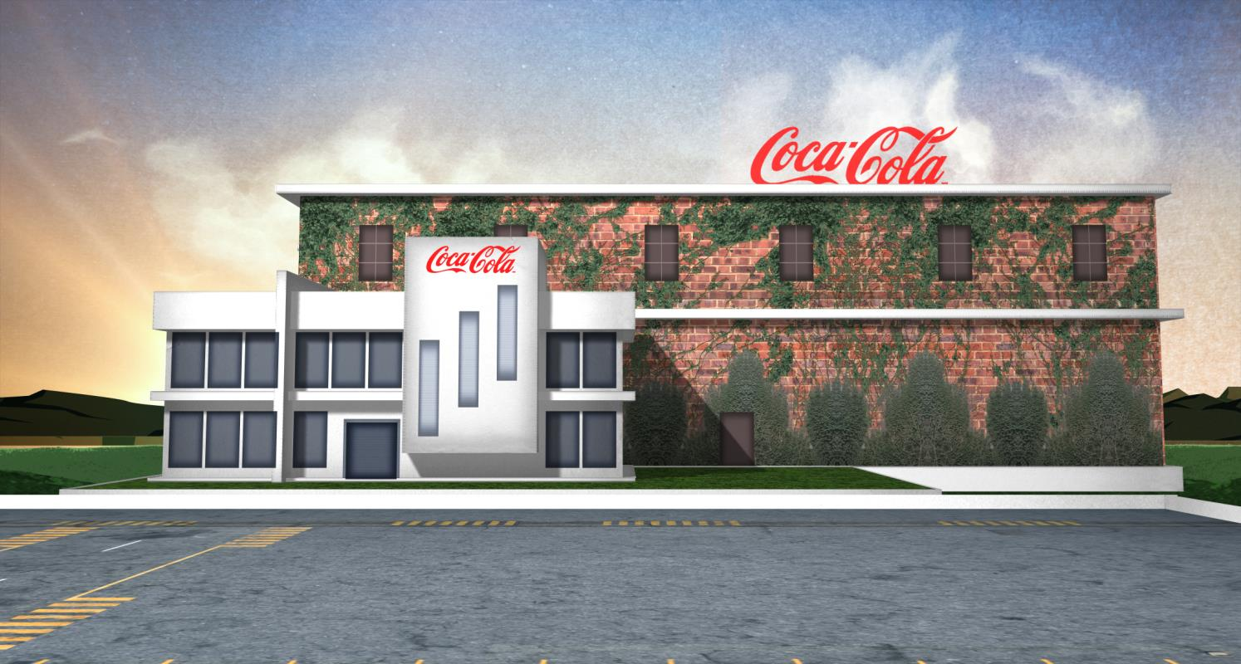


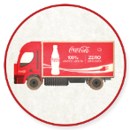
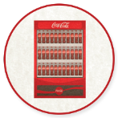

CLIMATE AMBASSADOR TRAINING
Module 3: IN ACTION: OPPORTUNITIES ALONG THE VALUE CHAIN
in partnership with

Slide 2

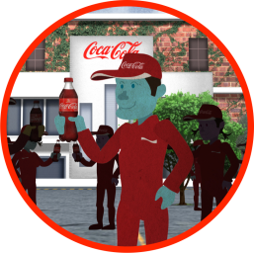
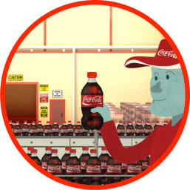
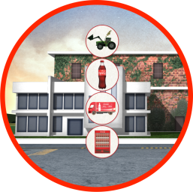
CLIMATE AMBASSADOR TRAINING AGENDA
WHERE WE ARE
MODULE 1: INTRODUCTION
MODULE 2: BUSINESS CASE
MODULE 3:
IN ACTION
• WHY WE ARE HERE
• GOALS • TRAINING OBJ. • DISCUSSION
• BUSINESS STRATEGY
• REVENUE • RISK
• REPUTATION
ME, WE, WORLD
• STRATEGIC FRAME
• KEY INTERVENTIONS
• INGREDIENTS
• PACKAGING
• MANUFACTURING
• DISTRIBUTION
• REFRIGERATION

Slide 3
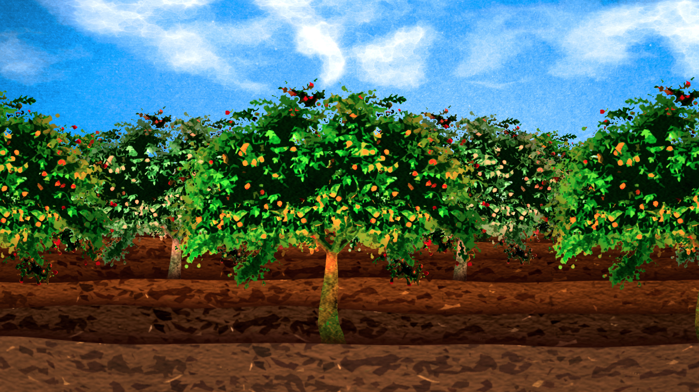
AGENDA
Opportunity Across the Value Chain
Ingredients
Packaging
Manufacturing
Distribution
Refrigeration
Notes:
Today we’ll review:
Identifying Waste and Opportunity across the Value Chain by reviewing cases across 5 areas
Ingredients
Packaging
Manufacturing
Distribution
Refrigeration

Slide 4


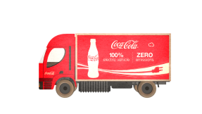
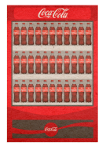


REMEMBER THIS?
VALUE CHAIN CATEGORIES OF FOCUS
INGREDIENTS
PACKAGING
MANUFACTURING
DISTRIBUTION
REFRIGERATION
13%
CO₂e
38%
CO₂e
9%
CO₂e
8%
CO₂e
32%
CO₂e
Notes:
Remember this?
It represents our value chain categories of focus, along with demonstrative emissions data from KO’s value chain. The emissions opportunities will differ for each product and each organization, but these numbers help illustrate that, as a global organization we have identified some hot spots in our cola chain. Within these areas there are some common intervention areas for our work.

Slide 5
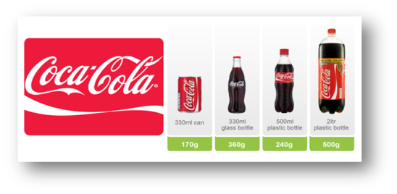
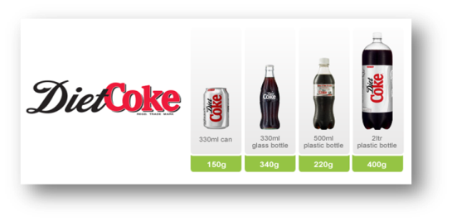
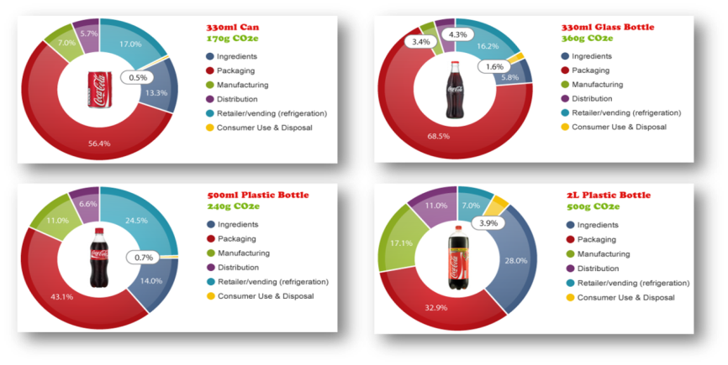
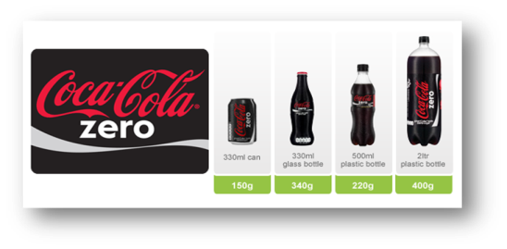
REMEMBER
OPPORTUNITY VARIES BY PRODUCT, PACKAGE
Notes:
Of course, it merits mention that the opportunity varies even INSIDE of the cola line, so, of course, it will vary even more across other products. Let’s now take a look now into each area, at some of the biggest problems, and some solutions that we, competitors, and peers are taking on. We’ll look at these through cases.

Slide 6

OPPORTUNITIES
(& KEY INTERVENTION AREAS)
Notes:
Why do we look at cases?
For two reasons:
First, to get a high-level idea for what the competitors and peers are doing with their suppliers and along their value chains. Some cases are not meant to provide deep technical knowledge, but to give you examples to share with their suppliers.
The second reason to review cases is to have a much better technical and business understanding of good practice. A select group of cases that we’ll review today have this business information, which you will be able to access online through esKO.
As we go through the cases, think not about what won’t work for you, but how you can stretch your suppliers, partners and customers to help Coca-Cola squeeze waste out. Because ‘carbon’ – or emissions – really represent loss – a cost to the system. In fact, we should look at emissions as savings and innovations opportunities.
And one we’ve squeezed the carbon out, it sets us up for seizing environment opportunities – revenue opportunities - like launching environmental brands and partnering with our retailers in ways that other companies can’t.
Let’s start at our ingredients – or, in essence, let’s go back to the farm.

Slide 7

Ingredients
Notes:
As in the video, we’ll head back to the farm. For many products, the “ingredients” area of the supply chain represents a significant climate opportunity. As we’ve seen in our own ‘overall’ value chain, it’s over 10%. But that number is even MORE significant when we look beyond colas to some of our fastest growing products: like teas, dairy products, and juices. With those types of products, the climate impact “at the farm” is even more significant. Let’s take a look.

Slide 8

KEY CARBON CHALLENGES
IN INGREDIENTS
FERTIILZER = HIGH GHG
SOIL MANAGEMENT = HIGH GHG
ENERGY USE ON FARMS
METHANE EMISSIONS FROM ANIMAL FARM WASTE
WASTE
Notes:
STRATEGIC FRAME
We’ll start by understanding the principal challenges at the ingredient level
Fertilizer = high GHG
Soil management = high GHG
Energy use on farms
Methane emissions from animal farms = energy source
Waste = emissions or energy opportunity
FINANCIAL FRAME
Many people have a tendency to seek out engineering solutions to the climate challenge. We assume they are easy and high impact. Interesting, in ingredients many of the practices we’ll discuss today are behavioral changes, including farmer training.
Most of these have low relative cost. But there also very high return practices like capturing methane emissions. Of course, financially, most of the cost savings in this area accrue to the supplier. In a study that we’ll review shortly, savings in just better fertilizer use can yield around 900millon/year for our ingredient suppliers. As good partners, we understand that what is good for our suppliers is good for us. It will also be important for them to lower energy consumption as we enter a time of rising energy prices – in all markets.
Back to the financial frame, sustainable and organic products are the fastest growing food segments in most country – remember the Green Brand study? That means there’s a revenue opportunity in working with suppliers too. Which means that you will want to seek out your marketing
STRATEGIC FUTURE
As we vertically integrate even further – by buying dairy farms or acquiring companies – this will become important to us as areas of cost savings.
And as importantly, related to sustainability priorities, The Coca-Cola Company Vice President, Procurement and Chief Procurement Officer Ronald J. Lewis recently said this about procuring ingredients: If we do this right, we will be able to accelerate progress against all of our sustainability commitments. Most notably, we know that water impacts in our agricultural commodities and ingredients are at least 10x those in our own operations. On an extended supply chain basis, agriculture is the number one contributor to the carbon footprint of our beverages. And of the more than half a billion small-holder farmers in the world, a large percentage is women.

Slide 9

PRACTICE
BETTER FARM PRACTICE
FERTILIZERS AND SOIL
WHY?
27%
SOIL EMISSIONS AND FERTILIZER
11%
DIESEL
4%
BEET TRANSPORT
57%
FUEL
1%
TRANSPORT
Notes:
Remember the “emissions map” of British Sugar’s sugar beet sugar that we discussed*?
WHY was so much energy lost in soil emissions and fertilizers?
ASK PARTICIPANTS: Who can explain?
ANSWER: The problem is that conventional fertilizers are responsible for a big portion of the emissions footprint of our products. This is generally even more dramatic with juices (remember Tropicana) and dairy products, as I’ve mentioned.
BUT WHY?
Manufacturing conventional fertilizers uses a great deal of energy.
In addition to that conventional fertilizers release nitrous oxide, a greenhouse gas that has about 300 times the warming power of CO₂.
Also, remember back to the surging energy costs. What is equally problematic with these conventional fertilizers: because manufacturing fertilizer is natural-gas intensive, farmers (and our businesses) are additionally vulnerable to fuel costs. We’ll see in a bit that this cost can hit our suppliers hard.
Let’s give scope the overall issue of emissions opportunity in agriculture. It’s a big area of GHG opportunity, and that’s why you’ll hear about this a few different ways today. As an example of how important it is, let’s look at the US: Agricultural soil management is the largest source of nitrous oxide (a greenhouse gas with 300x the warming power of Carbon Dioxide!) emissions, accounting for about 68% of total U.S. nitrous oxide emissions in 2010 (US EPA). Nitrous oxide is also emitted during the breakdown of nitrogen in livestock manure and urine, which contributed 6 % of nitrous oxide emissions in 2010.
In other words, there is a LOT of GHG opportunity in agriculture.
References:
*British Sugar and our Silver Spoon brand were pilot partners with the Carbon Trust in developing the PAS 2050 standard. Silver Spoon used it to analyse the carbon footprint of its home-grown granulated sugar.
Meanwhile, the carbon footprints of our Topsoil and LimeX brands, soil improvers supplied to the landscape and amenity industries, are also now certified according to PAS 2050. Topsoil produces 9kg of CO₂ per tonne of product and LimeX 2kg per tonne.
British Sugar has a target to reduce the carbon footprints of Silver Spoon, Topsoil and LimeX products by 10% by 2020.

Slide 10
SAMPLE INGREDIENT PRACTICES
WHAT COMPANIES ARE DOING
Better fertilizer use
Good soil management
Less/smarter use of fertilizer
Organic agriculture
Slow release fertilizers
Drip irrigation for more efficient fertilizer use
Methane to gas
Certification processes
Notes:
In this module, we review what other companies are doing to reduce GHG across their value chains. There are many practices, but we’ll talk over just a few of the KEY INTERVENTION AREAS:
Slow release fertilizers
Less fertilizer
Good soil management
Organic agriculture
Drip irrigation
Someone is wondering about the comparative ROI – or the return - for each of these practices. As we started this course, we discussed that working across the supply chain would challenge Coca-Cola’s traditional thinking on carbon reduction. The return – which is entirely dependent on what current practice is as well as geography, crop, etc. - must be calculated in conjunction with partners. Simply stated, we cannot compare the value of the practices because they will vary dramatically from region to region, crop to crop, supplier to supplier.
In situations of vertical integration, Coca-Cola bottlers can refer back to their farm management to help calculate basis.

Slide 11
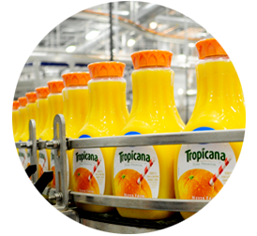

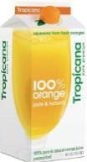

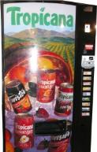

CASE: TROPICANA’S
BETTER FERTILIZER USE
INGREDIENTS
PACKAGING
MANUFACTURING
DISTRIBUTION
CONSUMER USE
35%
FARM OPERATIONS
15%
PACKAGING
24%
MANUFACTURING
22%
DISTRIBUTION
3%
CONSUMER USE
GOAL OF PRACTICE
↓ nitrogen oxides emissions from fertilizer = ↓ footprint of growing oranges by 50%
Notes:
As we’ve seen, Tropicana (which for scale, owns approximately 28% of US orange juice market, equivalent to 5Billion dollar market value), first mapped out its “emissions lifecycle” supply chain to understand where the opportunity was. (They did this through a carbon footprint analysis in conjunction with Columbia University's Earth Institute.) They found that the carbon footprint of its 64-ounce carton of Tropicana Pure Premium Orange Juice as 1.7 kilograms.

35% of it was attributed to fertilizers. And so they decided to focus on that area of their chain.
PRACTICE
Tropicana sought work with suppliers to use less-gas intensive fertilizer alternatives (and slow release fertilizers), aiming to lower footprint of growing oranges by 50%. They identified potential suppliers, communicated with them to establish partnerships, and then launched a three-year, 7,200-tree pilot project in Florida in 2010. This project is designed to compare less-carbon intensive fertilizers with standard fertilizer, and measure the impact on tree and soil health and juice quality. Results are due this year, but what’s going on now?
RESULTS
As a result of this work, Tropicana plans to deploy an optimized fertilizer solution across its Florida supply base, and globally to citrus and other crop production. If successful, the project could lower the emissions footprint of Tropicana’s citrus growers by as much as 50% and reduce the total carbon footprint of Tropicana Pure Premium Orange Juice by up to 20%. Tropicana’s parent company is also experimenting with the use of low-nitrogen, slow-release fertilizer on potatoes, which will not only reduce the company's footprint, but may also produce potatoes that are more uniform in size and yield more chips per acre.
That is one potential area for you to explore with suppliers – whether it makes sense to look at fertilizer alternatives.
Your colleagues at KO are exploring the economics of these fertilizers. The vendors claim that because less is used the cost to the farmer is less.

Slide 12
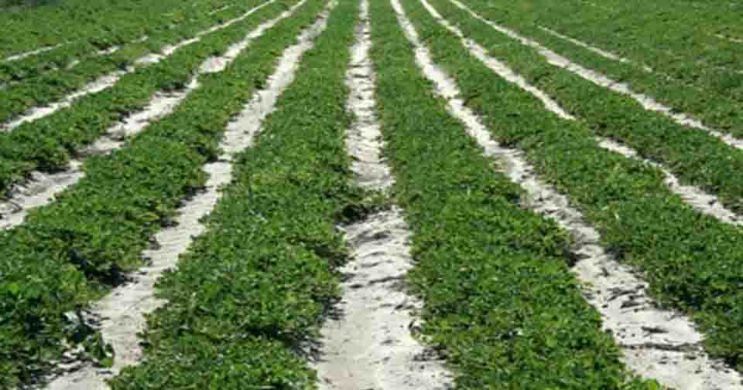
PRACTICE
GOOD SOIL MANAGEMENT
PROBLEM? Over-plowing & over-fertilizing = Excessive GHGs.
Notes:
So changing fertilizer is one method to reduce GHG, but many companies are simply looking at better soil management – which can not only cut GHGs but also cut costs. So, what does soil have to do with it?
First a definition: Tillage is the plowing of land done to 1) control weeds and pests, and 2) to prepare for seeding by bringing organic matter from the surface of the soil into the lower layer. So, plowing causes climate impact and provides opportunity?!
Frequent plowing (tillage) leads to loss of organic matter, erosion, and consequently loss of productivity of the soil. In order to compensate for the loss in productivity chemical fertilizers are regularly added.
With each plowing and application of fertilizer, both carbon dioxide and nitrous oxide are released into the atmosphere from:
organic matter that is now exposed releases carbon dioxide (CO₂) into the atmosphere
the decomposition of fertilizer that is now exposed to air releases nitrous oxide into the atmosphere. Nitrous oxide is a greenhouse gas that has about 300 times the warming power of CO₂.
the exhaust of machineries, which emits nitrous oxide and/or CO₂ depending on fuel used.
Both carbon dioxide and nitrous oxides are powerful greenhouse gases that lead to climate change.
THE BETTER PRACTICE IS: Simple, free changes to tillage practices can allow the soil to retain more organic matter (reducing how much fertilizer is needed) and can store or “sequester” carbon and nitrogen instead of releasing it into the environment as a greenhouse gas as methane, carbon dioxide and nitrous oxide. There are three main soil management techniques one can use to reduce climate impact:
no-tillage;
addition of manure and/or crop residue return), which reduces/eliminates the need for conventional fertilizers, and
crop rotation.
WHAT COULD WE EXPECT? The adoption of less intensive tillage practices on a large number of farms where Coca-Cola ingredients are grown could sequester substantial amounts of greenhouse gases. In addition to capturing these gases, better tillage reduces the need for nitrogen fertilizers. Studies conducted under a wide range of climatic conditions, soil types, and crop rotation systems have shown that no-tillage and reduced tillage practices result in better soils with significantly higher soil organic matter contents compared with conventionally tilled soils.*
WHAT THIS MEANS FOR YOU
Considering that much of the emissions footprint of our supply chain lies at the ingredient stage working with suppliers on better farming practice can lead to big improvements. (With products like unrefrigerated orange juice, up to 40% of the product’s emissions footprint may be found at the farm!)
You can consider working with suppliers on simple practices like these -simple behavior changes - to reduce the carbon footprint of the drink in your hand.
Here are some opportunities FOR COCA-COLA’S farming suppliers TO REDUCE CLIMATE IMPACT**
1) Sequestering carbon in agricultural soils by reducing tillage.
2) Reducing nitrous oxide emissions through more efficient use of nitrogen fertilizer.
3) Developing viable technologies for creating nitrogen fertilizer from feedstocks other than natural gas.
4) Expanding the use of practices like forested riparian zones to increase soil quality by reducing erosion.
5) Capturing methane emissions from anaerobic manure handling facilities.
6) Substituting renewable fuels for gasoline, diesel fuel and natural gas used on the farm.
7) Increasing the generation of electricity from wind and other renewable sources.

Slide 13
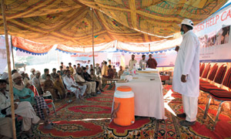
HOW ARE COMPANIES DOING IT? CASE: NESTLE FARMER TRAINING
Nestle Agricultural Services Teams
273,808
Farmers trained through capacity-building programs in 2012.
©Nestle
Notes:
How are companies doing this?
Nestle invests significantly in capacity building for its supply chain. For example, in 2012, Nestle trained 273,808 farmers on business and better farming practice.

Slide 14
BUSINESS CASE AT TCCC
BETTER FERTILIZER
MANAGEMENT IN CITRUS
SIMPLE PRACTICE: Better placement of fertilizer
CO₂e reduction
with best practice
Annualized savings
Savings per ton
8,039t
2.4million USD (price offset, accruing
to farmers)
301 USD (price offset)
*Costs of farmer training not included in business case; however savings could fund training through train the trainer model.
Notes:
Now let’s look at a BUSINESS CASE or less fertilizer use with the KO orange supply chain from Brazil. The problems are the same as at Tropicana: fertilizer use is a huge GHG contributor. But the problem is more nuanced than that. In fact, we can simply REDUCE the amount of fertilizer and not shift operations, like we discussed in the soil management case. That, too, has an excellent result. The better practice is to reduce fertilizer by placing it more strategically near the plants and caring for the soil so the soil can rebuild its own nutrients.
By following best practice fertilizer usage in all groves in Brazil from where it sources oranges, Coca-Cola’s supply chain emissions for Brazilian oranges could be reduced ~8,000 t CO₂e. Current fertilizer application could be reduced by 45% to yield same effect and reduce carbon emissions. That reduction in fertilizer use has clear cost implications. It reduces costs for our suppliers. Lower costs, lower GHG. The kinds of opportunities that we’re looking for.

BUSINESS CASE*
CO₂e reduction from switching to best practice 8,039t
Annualized savings 2.4 million USD
Cost per ton 301 USD
*Costs of farmer training not included in business case; however savings could fund training through train the trainer model.
These are simple behavior changes, but farmers are untrained in best practices in placement of fertilizer and are not conducting soil/leaf analysis. That shouldn’t make you feel powerless, it should make you think:
DISCUSSION:
Let’s assume you decided that your biggest opportunity were in reducing fertilizer in your citrus groves. Together with procurement, you identified your supplier partner; but they asked for training for farmers. What ideas would you have?
(Instructor can discuss options of funding farmer education directly, of collaborating with local nonprofits, of funding local nonprofits, etc.)

Slide 15
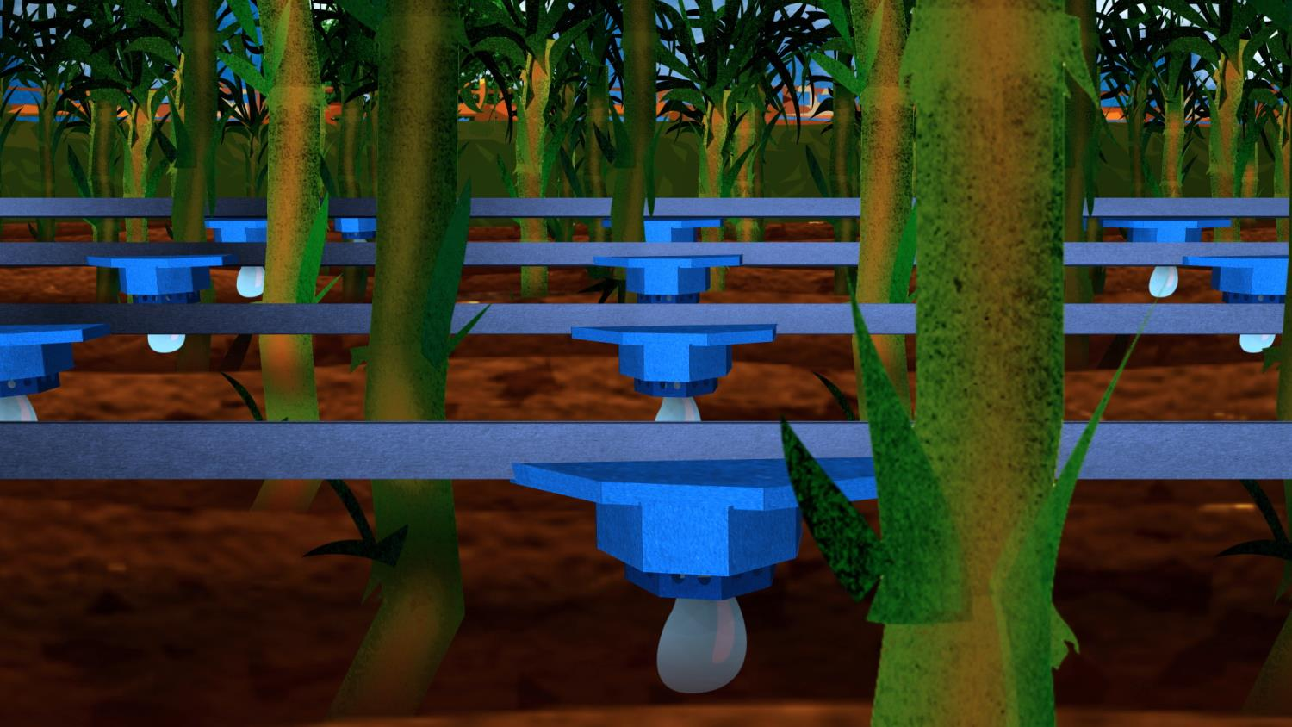
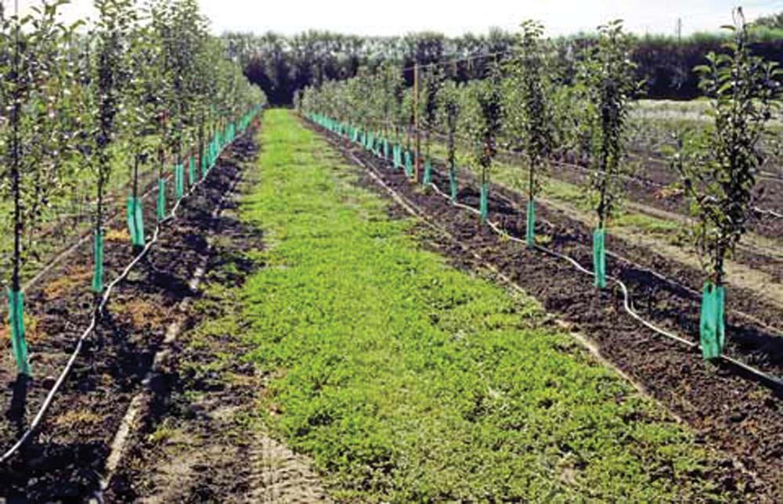
PRACTICE
DRIP IRRIGATION
MORE EFFICIENT H20 & FERTILIZER USE
USA
+19% yield
-20% water
$15/acre savings
INDIA
+31% yield
-50% water
Credit: Sustaining River Life
Notes:
Drip irrigation systems normally place the water directly into the soil or onto the soil surface. Drip irrigation uses tubes to deliver small quantities of water and nutrients straight to the plants roots, leading to less wastage and evaporation than systems such as overhead and furrow irrigation. Drip irrigation involves applying separate droplets of water directly to the plants’ roots via a network of pipelines – dramatically cutting water use by as much as 50%.
This reduces the risk of run-off – a very important practice to reduce fertilizer use and therefore GHGs. Of course this also improves water application efficiency. Drip irrigation systems can be classified as traditional drip irrigation system, subsurface drip irrigation and low cost alternative systems.
By creating optimal growing conditions for the plant, it typically also creates improved growing conditions and boosts yields by up to 25-35%. It can significantly reduce the spread of fungal diseases and because soil does not become soaked through; it also helps to prevent bacterial diseases.
DESCRIPTION OF PRACTICE + RESULTS
Drip irrigation technology provides many benefits – including:
improved yield,
reduced water use, and
reduced fertilizer use. Farmers can apply nitrogen several times in smaller targeted amounts, optimizing nutrient uptake and reducing climate impact from the release of nitrogen dioxide from fertilizers into the atmosphere. Flooding irrigation also washes away fertilizer – into the water supply – a huge concern for Coca-Cola.
CASE
A global beverage company evaluated the impact of drip irrigation technology on water and chemical use efficiency, and its effect on the energy footprint of potato production over a period of 3 years. Their work is published in white papers, which is where we found this information. The results from their work on potatoes in the US and India follows:
US
In the US, studies show irrigation water reductions of more than 20 percent, with an average yield increase of 19 percent. By utilizing drip irrigation to deliver crop inputs, producers can reduce the number of tractor passes over the field, while optimizing timing and accuracy of delivery. Drip irrigation improves plant health and crop yields, and save one tractor pass over fields, which equates to a savings of $15 per acre when implemented in the US.
INDIA
In India, approximately 40 percent of the potato-growing area (2 million out of 5 million acres) is water-scarce. Therefore, the use of drip irrigation provides an opportunity to improve productivity.
The company facilitated loans at favorable rates to small scale farmers to help with needed equipment.
“As a result of the program—affecting 850 farmers covering more than 1,000 acres in the state of Maharashtra—the average yield has increased from 5.5 metric tons to 7.2 metric tons per acre in drip irrigation fields, a 31 percent increase in productivity. The drip irrigation program has also delivered a 50 percent reduction in water usage in potato cultivation, resulting in a total water savings in 2010 of 200 million liters of water, versus flood irrigation.” Based on the success in Maharashta, the company is replicating the program in other water-scarce Indian states. The company hopes to expand drip irrigation acreages threefold over the next three years.
RELEVANCE TO COCA-COLA
Optimizing farming practice – water and fertilizer use – is critical for Coca-Cola to meet its climate commitments. Drip irrigation can provide significant productivity, water, and climate benefits when implemented well.
As with all of our cases, there are technical and/or vendor resources available on esKO.

Slide 16
FINANCIAL CASE
ORGANIC SUGAR
IN INDIA
OPERATIONS ORGANIC & CONVENTIONAL | ORGANIC | CONVENTIONAL | % CHANGE
Land preparation | 5,838 | 5,307 | 10.0%
Seed and planting | 5,372 | 6,974 | -23.0%
Manures | 10,534 | 5,242 | 101.0%
Chemical fertilizers | - | 8,980 | -
Weeding and inter-culture | 5,157 | 4,959 | 4.0%
Irrigation | 5,986 | 7,587 | -21.1%
Plant protection | 781 | 1,274 | -38.7%
Others | 1,964 | 1,792 | 9.6%
Total* | 35,632 | 42,115 | -15.4%
Cost of cultivation of organic and conventional sugarcane crop (Indian rupee)
Notes:
There are many opportunities related to fertilizer and soil management. We won’t cover them today; the last we’ll talk about today is Organic Farming, specifically organic sugar in India.
Nitrogen fertilizer is industry’s biggest expense
Organic nitrogen fertilizer is cheaper and as effective
Organic farming requires better tillage practice
Environmental benefits:
The adoption of less intensive tillage practices on a large number of farms could sequester substantial amounts of carbon and nitrogen, allowing agriculture to contribute to global efforts to reduce and control greenhouse gas emissions.
Organic farming conserves water
There are a lot of myths about organic farming that we should spell out are not true:
In long-term studies, it can be as productive as conventional farming.
It generally is less expensive.
The risk can be managed with integrated pest techniques.

Slide 17
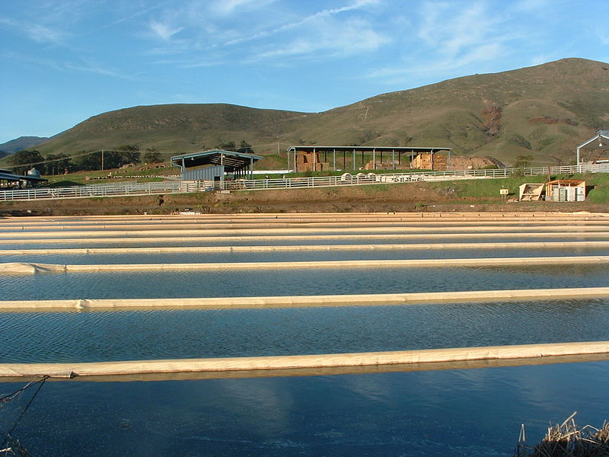
CASE: CARGILL’S
METHANE TO BIOGAS
ON ANIMAL FARMS
Sample Results: Biogas now displaces 20-25% of natural gas demand at all eight of Cargill’s US meat processing plants.
Notes:
What else are companies doing with their suppliers to reduce the emissions footprint?
MANY things – like biomass to energy generation and renewable energy to reduce energy use.
QUESTION: What do you know about?
Let’s take a look at biogas….
DISCUSSION: How many of you are using biogas in your facilities? (Note that there is a case on Biogas from Coca-Cola Andina on esKO.)
In this case, we’ll look at reclaiming METHANE to turn to BIOGAS ON ANIMAL FARMS. The problem of course is that animal manure releases significant methane into the environment, but the opportunity is immense for capturing a fuel source. This is a good example of one of the key lessons about the cost side of the business case: emissions equal money!
DESCRIPTION OF PRACTICE. Cargill has many biogas projects around the world, including sites in Mexico, South Africa, China, Honduras, Thailand, Indonesia, and the Philippines. At its beef and pork plants, Cargill captures methane from wastewater lagoons (areas where manure is held) and then uses the methane to fuel the boilers that power its plant. Using this methane significantly reduces Cargill’s fossil fuel use. These types of projects are particularly appropriate for dairies and/or fully integrated farms.
RESULTS

US
Biogas now displaces 20-25 percent of natural gas demand at all eight of Cargill’s US meat processing plants. Using the biogas reduces greenhouse gas (GHG) emissions by more than 1.3 million metric tons in the last four years. The amount of renewable biomass Cargill used in 2009 would be enough to power the complete energy needs of a town of 100,000 people (in the US).
KOREA
Cargill announced an investment in a biogas project on in Jeju, Korea. Transforming waste from hog farms, the site will generate almost 700,000 kilowatt-hours of electricity each year.
HOW IS THIS RELEVANT FOR COCA-COLA BOTTLERS?
For all dairy products or integrated farms, there are significant low cost operational improvements that can generate energy AND cut costs.

Slide 18

EMISSIONS ARE ENERGY
(ENERGY IS MONEY)
Notes:
Why should you care? Coca-Cola has set goals in climate and in sustainable procurement to better your business, but why should your suppliers care?

Because emissions are energy; and energy is money.
As energy costs grow, the more expensive your commodities will be.
And the more emissions you’ll have to deal with down the line – when we’ll face the growing pressure of our customers, consumers, communities – and regulators.

Slide 19
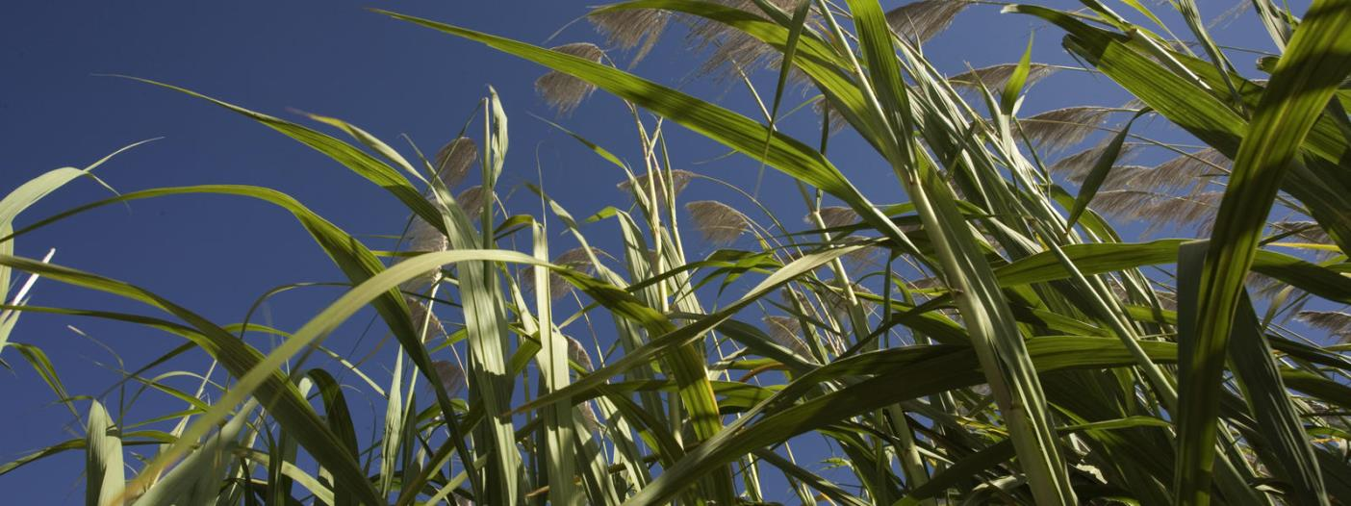


CASE: COCA-COLA
BETTER SUGARCANE
GLOBALLY
Notes:
Remember the business case. (It’s not all about Risk.)
Revenue, Risk, Reputation. And then think about this practice:
DESCRIPTION OF PRACTICE.
One way in which KO and WWF have partnered is on Sugar Cane production. Together, WWF and Coca-Cola have piloted projects on sustainable sugarcane cultivation in Australia, Brazil, South Africa, and Honduras, working with sugarcane farmers to align their practices with the Bonsucro Standard, a standard for sustainable sugar cane production.

Slide 20
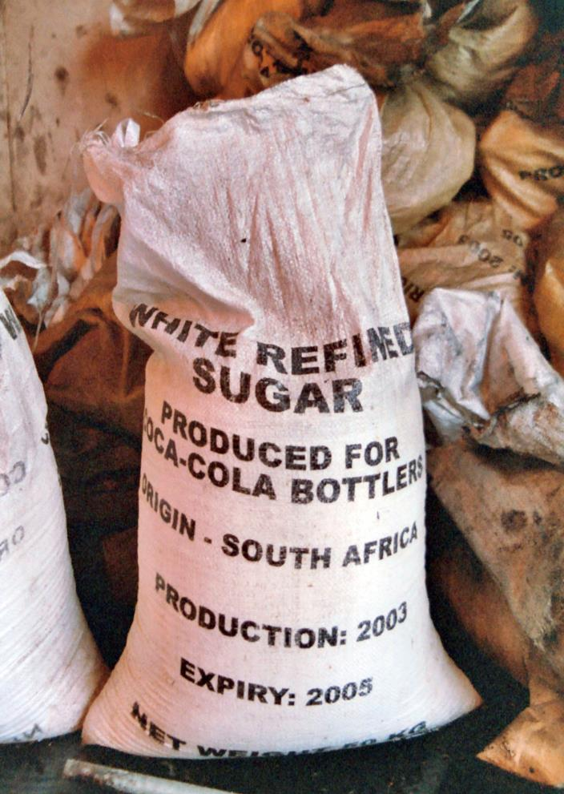
SUGARCANE
Sugar is the 7th largest source of human calories (80% is from cane)
2nd largest source of ethanol, globally
Grown in over 100 countries
© WWF-Intl / Rachel Wiseman / WWF-Canon
Notes:
Sugar is the 7th largest source of human calories – it’s grown around the world and it’s a primary ingredient in many of Coca Cola’s products and the production of which not only requires a lot of water and fertilizer inputs, there are a number of best practices that can enhance productivity while decreasing the environmental impacts of that process.
PROBLEMS
Seventy percent of the world's water is used for agriculture. Sugarcane, one of Coca-Cola’s important ingredients, is also one of the world’s thirstiest crops. It has a significant impact on many environmentally sensitive regions, like the Mekong Delta and the Atlantic Forest.
Pollution
Silt from eroded soils and nutrients from applied fertilizers often foul water supplies. Sugarcane processing also creates effluents that flow into water and damage important ecological areas. Water quality concerns have prompted a reduction in production in certain areas, with production consequently intensified and expanded onto sandy soils. Because such soils are easily leached, production can only be maintained over time with increasing applications of fertilizer.
Industrial waste
Sugar mills produce wastewater, emissions and solid waste that impact the environment. The massive quantities of plant matter and sludge washed from mills decompose in freshwater bodies, absorbing all the available oxygen and leading to massive fish kills. In addition, mills release flue gases, soot, ash, ammonia and other substances during processing.
Soil erosion and degradation
Land laid bare in preparation for cane planting is stripped of any protective cover, allowing the soils to dry out. This impacts overall microorganism diversity and mass, both of which are essential to fertility. Additionally, exposed topsoil is easily washed off of sloping land, with nutrients leached from the topsoil. Further, the continual removal of cane from the fields gradually reduces fertility and forces growers to rely increasingly on fertilizers.
Loss of biodiversity
Historic planting of sugarcane around the world has led to significant impacts on biodiversity.
BUSINESS CASE FOR ACTION
Managing social and environmental risks is important for sugarcane growers, processors and food companies due to regulatory pressures as well as shareholder and consumer expectations for sustainably produced goods.
DESCRIPTION OF PRACTICE.
In June 2011, a sugar mill in São Paulo, Brazil, became the first to be certified under the Bonsucro standard, and the Coca-Cola system was the first buyer of the mill’s certified sugar. Since then, 16 sugarcane mills have been certified in Brazil. By the end of 2011, Bonsucro-certified mills had produced approximately 1.6 million tons of sugar.
In Australia, WWF and Coca-Cola continue to work with sugarcane growers to improve their farming practices. To date, growers have improved the water quality of more than 26 billion gallons of runoff and drainage water. These efforts have reduced over 183 metric of fertilizer and herbicide run-off from polluting the Great Barrier Reef.

Slide 21
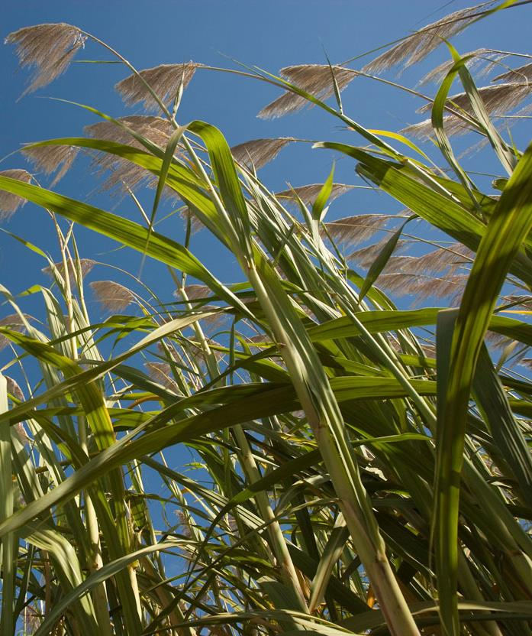
AGRICULTURE IMPROVING STANDARDS AROUND THE WORLD
The Challenge
33% of Earth’s surface for crop production; 55% of habitable area
Half of the topsoil lost globally
Agriculture uses 70% of the world’s water
WWF’s Response
Work with multi-stakeholders to develop and define credible standards
Test and demonstrate the commercial benefits of better management practices
© Martin Harvey / WWF-Canon
Notes:
At WWF we think a lot about this. As Matt mentioned earlier, the 50+ years that we’ve been in business have been focused on protecting spaces and species. As we matured and become more sophisticated, we’ve come to understand that a primary driver behind environmental degradation is agriculture. Since we don’t want to ask people to stop growing their food, we’ve taken what we think is a proactive and realistic approach to the issue by engaging agriculture with the hopes of making agriculture better – smarter, with higher yields and more efficient and smarter uses of resources so that we can do more with less.

Slide 22
Sustainability
Long term need for raw materials and managing risk.
© Kate Holt / WWF-UK
Notes:
RELEVANCE TO COCA-COLA
Sustainability for us at WWF means a lot of things. Agriculture an important opportunity for WWF in our mission.
One way of looking at sustainability, and specifically through the business lens is that sustainability means profitability in perpetuity. One important component of the long term viability of a company is the consistent supply of raw materials. Today supply risk is born of a number of drivers – the cost of a raw materials is fluctuating due to the effects climate change is having on yields.
Though the company does not have direct control over farm practices, its purchasing power can influence the entire industry.

Slide 23
THE BIG PICTURE
CARBON WITHIN PRODUCT LIFE CYCLE
PRODUCT
DESIGN
OPTIMIZE
VALUE
CHAIN
USE & END OF LIFE
Notes:
Carbon is present from cradle to grave, so minimizing it up front is the best policy. For example, light-weighting a bottle uses less material, uses less fuel, equals less waste, and so on.
Product Design
Resource & material choice
Packaging design
Green product development
Optimize Value Chain
Logistics: Production location, producer & transport choice
Green procurement
Local sourcing
Supplier carbon management
Use & End of Life
Consumer education
Resource conserving products
Recycling or compostable packaging

Slide 24
DISCUSS
What ingredient initiatives do you have underway?
How did you decide upon which to undertake?
Notes:
DISCUSS
What ingredient initiatives do you have underway?
How did you decide upon which to undertake?

Slide 25
DISCUSSION
Scenario
You
One of your citrus supplier
Notes:
Scenario:
At this point, you’re wondering how you can assess your opportunities and set your targets. But that’s really only one engineering part of getting things done. In fact, if you were actually optimizing the current solutions, you might have met your carbon target. What Coke is trying to now is trying to influence someone.
So here’s where we are. You don’t know what the best opportunities are. And you’re not going to know what those best opportunities are until you have a conversation with your suppliers, no matter how many times you’ve calculated it because you don’t know what they’re doing. Depending on the SUPPLIER, that person might not even know what they’re doing.
A lot of you feel uncomfortable. You should. You have no control of getting this done without collaboration.
Discuss these questions as if you were asking the President:
What questions would you ask your supplier to better understand if there is opportunity?
How do you ask it?
Discuss these questions as if you were asking the Head of Farming Production:
What questions would you ask your supplier to better understand if there is opportunity?
How do you ask it?
LEARNING POINT
Don’t assume.
You can’t set a target and assume that’s the answer.
You actually have to engage.
You need to ask questions of the supplier.

Slide 26

Packaging
Notes:
Now to packaging. Across all of our products, packaging is a significant emissions challenge. We need to look at better packaging solutions, not ONLY because of GHG, but also because of the increase in fuel and materials costs over the next years.
ASK: Who recalls what the cost increase is expected to be for PET?
We’ll look at a couple cases now that are not highly technical. You can only get highly technical once you are working directly with your local/regional suppliers to fit in their current technology possibilities. But let’s see what other companies pushed their suppliers to do.

Slide 27
PACKAGING
SIGNIFICANT SOURCE OF CARBON
INGREDIENTS
PACKAGING
MANUFACTURING
DISTRIBUTION
REFRIGERATION
13%
CO₂e
38%
CO₂e
9%
CO₂e
8%
CO₂e
32%
CO₂e
Notes:
Remember this?
It represents our value chain categories of focus, along with demonstrative emissions data from KO’s value chain. The emissions opportunities will differ for each product and each organization, but these numbers help illustrate that, as a global organization we have identified some hot spots in our cola chain. Within these areas there are some common intervention areas for our work.

Slide 28
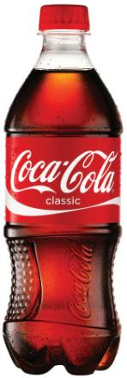
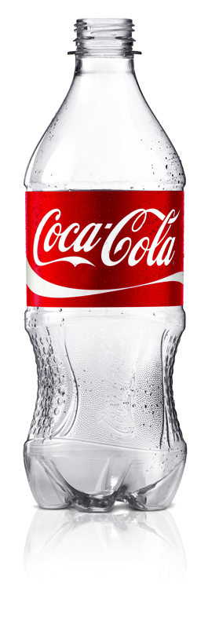
BOTTOM LINE VALUE PACKAGING: KEY COST COMPONENT
BOTTLE COST
~30%
28

Slide 29

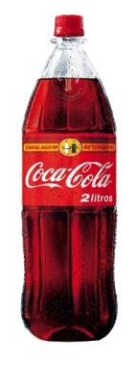
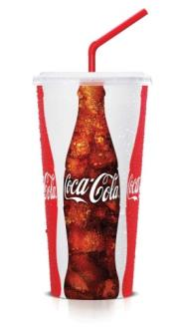
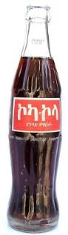
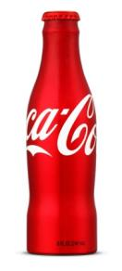
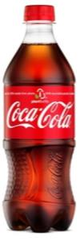
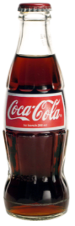
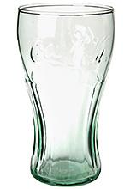
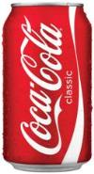
Fountain 10%
Glass
Metal 14%
PET Plastic
Refillable 12%
PET Plastic 51%
Non-Refillable 1%
Refillable 7%

Slide 30

PRINCIPAL CHALLENGES
IN PACKAGING
WEIGHT
(FUEL)
MATERIAL USE
MATERIAL CHOICE
REFILLABLE
WASTE/
RECYCLING
Notes:
STRATEGIC FRAME
We’ll start by understanding the principal challenges in packaging:
Weight = more fuel in transportation
More material use
Material choice
Waste and recycling
We should view this through the lens of our commitment:
Coca-Cola has an “additive approach”; we want to be sure we’re doing all the right smart things.
For PET, TCCC has committed that all PET will be first generation PlantBottle by 2020 because it:
Is a proven brand building asset
Drives Corporate leadership
Hedges against oil pricing
FINANCIAL FRAME
The frame here is both cost and revenue. There are opportunities on both side. As we light-weight our packages, we make our fuel expenditures and logistics much less expensive. As we develop new innovative packages, we can expect to see marketing benefits accrue. Remember back to the 7 point increase in purchase intent that we saw with the Plant Bottle case that we discussed earlier.
STRATEGIC FUTURE
With rising fuel prices and increasing demand for environmental products, this isn’t just a climate argument, it’s business critical. Let’s look and see what’s going on at peer companies.

Slide 31
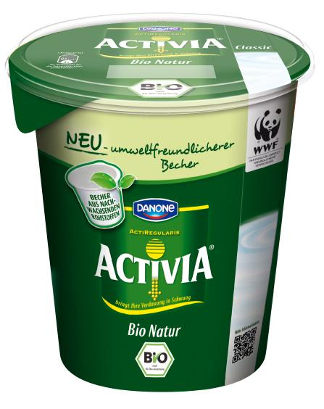
CASE: DANONE, STONYFIELD FARMS
LOW-DENSITY PLASTICS
Notes:
Danone and StonyField Farm both sought out suppliers who could develop and provide low-density plastics for their yogurt pots to reduce carbon dioxide emissions during production – AND to serve as a competitive advantage for their product.
DESCRIPTION & RESULTS – DANONE. The “Foam Project” set out to optimize the yogurt package’s shape, weight and volume by using a technology aimed at inserting bubbles into polystyrene to create a low-density plastic. This allowed for a 19% reduction in the density per gram of packaging and a 6% reduction in CO2 emissions. This particularly efficient technology still makes it possible to maintain the packaging's other functions: food safety, displaying nutritional information about the products, and visibility. In 2009, Danone deployed this technology on 26 production lines in 8 countries. By end 2012, they estimated this would be installed across 110 lines.
WHAT’S IMPORTANT ABOUT THIS CASE FOR COCA-COLA? Danone goes to its suppliers and requests that they work with them on packaging. And the work for years to develop better materials and ideas. To have packaging out in a few years, you need to start thinking about, and partnering with, your suppliers now to develop plans and financial calculations that discount out the fuel saving from shipping a much lighter product. We’ll talk about that next.
Another important point on this case beyond the environmental and cost savings. Remember the global brand study: -At least a quarter of consumers in all countries say that packaging has the greatest impact on their likelihood to purchase green products.
The biggest takeaway from this case can be pulled from this quote from Danone’s CEO:
Danone favors a decentralized structure and encourages its teams in the field to develop (its sustainability/innovation) initiatives in line with local habits and expectations. The most successful local experiments are replicated in other countries.
DISCUSSION. The question and next step for you is to ask at your facility:
Do you have a mechanism in your company so that you are engaged in your conversations about product development? Do you have the right strategic and technical resources at the table?
If so, share.
If not, how can you get it? What needs to happen?
ADDITIONAL CONTENT
DESCRIPTION & RESULTS – STONYFIELD FARM
The global organic yogurt leader, Stonyfield Farm, has replaced all of its petroleum-based multipack yogurt cups with a plant-based packaging alternative Ingeo™ created by NatureWorks. These plant-based cups reduce the package’s greenhouse gas emissions by 48%.

Slide 32
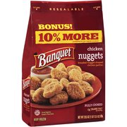
CASE: CONAGRA TEAMS COLLABORATE FOR
REDUCED PACKAGING
THIS BAG SAVED
IN ONE YEAR
79,200 gallons of diesel
At current fuel prices, >$250,000
Notes:
This is another case to get you thinking about how working across departments can really pay off. Conagra was able to reduce its packaging, not because it was seeking the environmental marketing advantage that Danone and Stonyfield get from their packaging, but because of the fuel savings they could yield from more efficient packaging materials
ConAgra was able to reduce packaging materials by 1.8 million pounds annually by optimizing its Banquet® chicken bags. More efficient packaging means more efficient truck utilization — 79,200 gallons of diesel fuel were conserved in the first year. At current fuel prices, this is equal to well over $250,000 in just fuel costs.
This speaks to the need to start thinking broadly with your departments. How can you work with marketing and fleet to build better products/packaging that wins on both sides?
Another practice at ConAgra demonstrates how to collaborate with suppliers: ConAgra partnered with a supplier and a customer to develop a first-of-its-kind package for its line of Lamb Weston® frozen potato products. Traditional frozen French fry bags have layers of both paper and plastic, but ConAgra’s new bag is now recyclable in its re-pulping facilities. After training its customers on how to manage recovery of the new bags, 25,000 pounds of materials will be recycled by the customer each year. This is equal to 396,000 French fry bags not going to a landfill.
WHY IS THIS RELEVANT TO COCA-COLA? Because collaborating – fleet, marketing, packaging – you can discover win-win-win product innovations that create real value for the company.
How can this happen at your facility? What packaging opportunities are you missing?

Slide 33
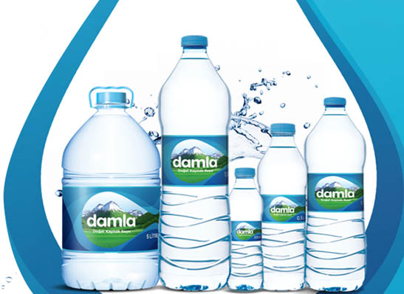
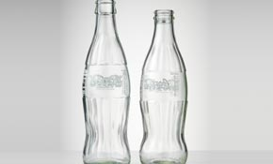
COCA-COLA’S CONTINUED FOCUS ON
MORE EFFICIENT PACKAGING
Notes:
Creating More Efficient Packaging In 2010, we continued the innovative light-weighting of our packaging that has proven to save costs, materials and resources. In fact, in 2010 we saved $90 million by reducing packaging waste. Here is a snapshot of our efforts from around the world:
We launched a 10.5-gram Damla 500-ml PET bottle in Turkey.
Our operations in the Philippines reduced the use of glass material by 20 percent through the continued rollout of Ultra Glass.
We avoided $5 million in costs by rolling out the 1881 short-height closure on large polyethylene terephthalate, better known as PET, bottles in North America.
Ultra-glass:
The innovative Ultra Glass contour bottle is designed by Coca Cola Company to improve impact resistance, reduce weight and cost. These bottles are 40 percent stronger, 20 percent lighter and 10 percent less expensive than traditional contour bottles. Use of the Ultra Glass design has eliminated 52,000 metric tons of glass resulting in a CO₂ reduction of 26,000 tons.

Slide 34
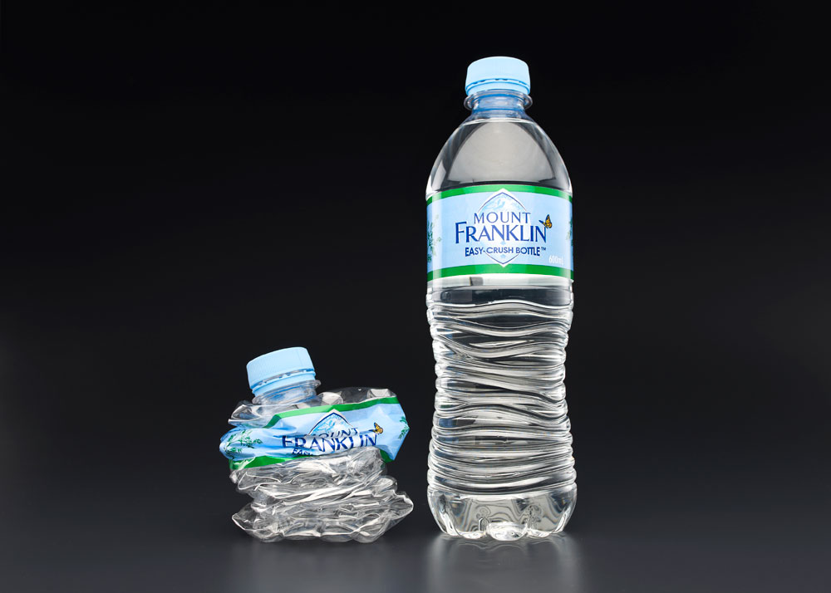
CASE: COCA-COLA AMATIL
BLOW-FILL TECHNOLOGY
$450million group-wide roll-out
9,000 tons of PET resin will be saved a year
Notes:
In 2007-2008, Coca-Cola rolled out a process to lightweight its range of 500ml plastic PET bottles by reducing the overall packaging weight from 26g to 24g, representing a material saving of 8%. The change has affected 700 million bottles annually – including Coca-Cola, Diet Coke, Fanta and Sprite – saving approximately 700 tons of PET each year.
In 2011, Coca-Cola Amatil (CCA) continued the $450 million group-wide rollout of blowfill technology, or PET bottle self-manufacture technology, with three additional lines commissioned in Australia. Blowfill technology enabled CCA to design new lightweight primary and secondary packaging, and has enabled the saving of thousands of tons of raw materials.
CCA’s Mount Franklin Easy-Crush bottle went into the market in 2011 as the lightest Australian-produced 600ml water bottle made with 35 percent less PET plastic and a carbon footprint that is 27 percent less than the previous Mount Franklin bottle. The Mount Franklin Easy-Crush Bottle is also 100 percent recyclable and easily crushed when empty, making it easier to recycle.
This innovation was awarded gold in the Australian Packaging Covenant Sustainability Award category of the 2011 Australian Packaging Design Awards. Blowfill technology has enabled CCA to lightweight its entire small carbonated soft drink PET plastic bottle range, making the bottles the lightest in the global Coca-Cola system. When the rollout of the blowfill technology across the group is completed in 2015, it is estimated that more than 9,000 tons of PET resin a year will be saved.
WHY IS THIS RELEVANT FOR COCA-COLA BOTTLERS?
On revenue side, we see 7 percent increase in purchase intent with products like PlantBottle.
For companies like Britvic that introduced a new lighter bottle in 2008 for its one liter Robinsons squash – the UK’s best-selling brand of squash. The bottle is 2g lighter than the previous container, saving over 300 tons of PET each year, and reducing the energy needed to manufacture the bottle by 5%. The changes have also enabled 25% more cases of Robinsons to be loaded onto pallets, reducing lorry loads, fuel costs and carbon emissions.

Slide 35
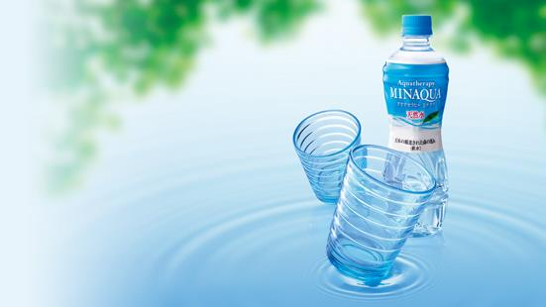
CASE: COCA-COLA JAPAN
LIGHTWEIGHT “ECO” DESIGN
3 years 5% share
Unhappy bottlers

Slide 36
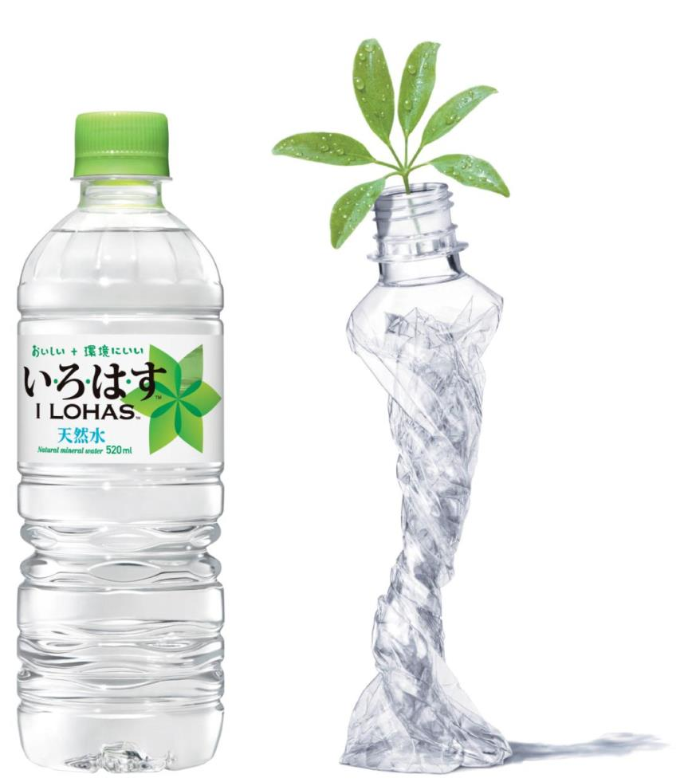
2 YEARS
Same water same price
41.2% SHARE =
ONE BILLION $USD

Slide 37
“The best way to predict the future is to design it”
- Buckminster Fuller
Notes:
Assumes we focus on continuous improvement. For PET…advance lower carbon solutions, manage cost and continue to meet consumer need

Slide 38
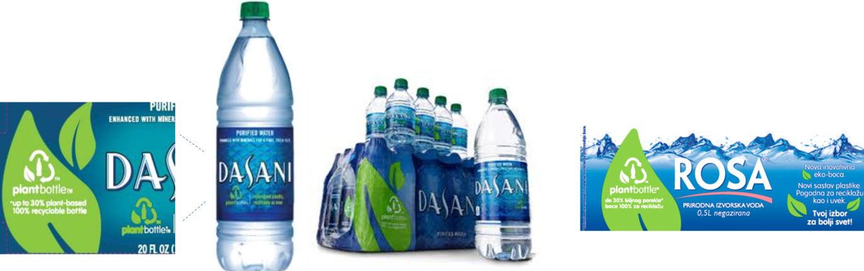
PLANTBOTTLE
A STRATEGY FOR THE FUTURE
Notes:
PlantBottle packaging has proven to drive sales (both volume and value), drive brand love (trial & repeat), and drive additional distribution to more customers.
And in general, the reason TCCC is so heavily invested in PlantBottle is:
1.) Corporate Leadership Opportunity
· Packaging is TCCC’s largest CO2 source
· PlantBottle reduces environmental impact
· PlantBottle will change entire plastic industry
2.) Hedge Against Oil Pricing
· PET is ~60% of TCCC packaging and growing, critical to 2020 goal
· Oil pricing is highly volatile and trending up
3.) Brand Building
· When promoted correctly, PlantBottle is an ownable point of differentiation driving trail & repeat
· Natural cues of packaging reinforce positive qualities of product
· PlantBottle fights negative category perceptions among customers and consumers
All PET will be first generation PlantBottle by 2020

Slide 39
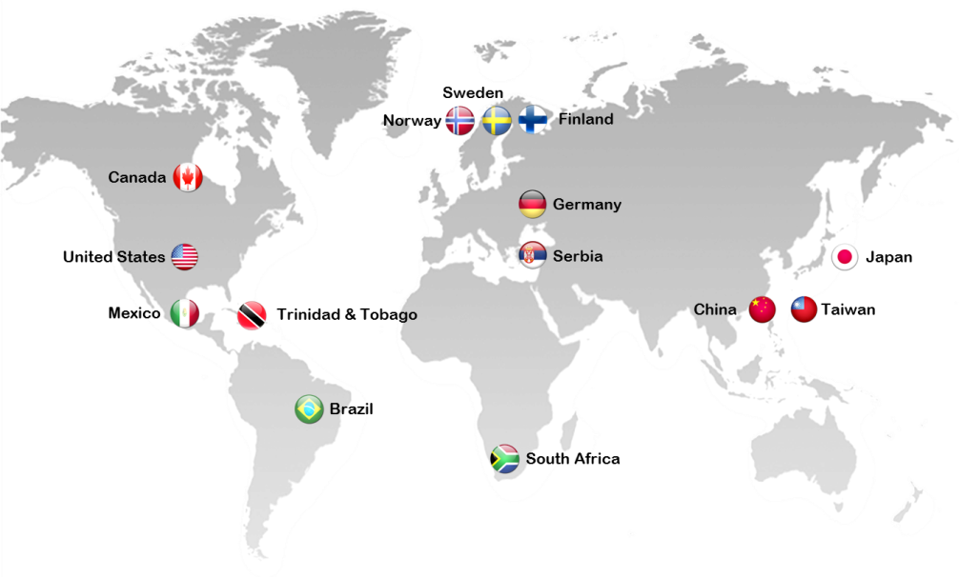
ACCELERATING
PLANT BOTTLE EXPANSION
Since 2009 launched 12 markets in water, brands helping advance our brands with meaningful differentiation versus competition.
Notes:
Water Brands:
2009 – US & Canada Dasani
2010 – Japan iLOHAS
2010 – Sweden & Norway Bonaqua
2011 – South Africa Valpre
2011 – Germany ViO
2012 – Serbia Rosa
2012 – Mexico Ciel
2012 – Brazil Crystal
2012 – Hong Kong & Taiwan Bonaqua
2012 – US & Canada smartwater
2013 – Trinidad & Tobago Dasani
2013 – Finland Bonaqua

Slide 40
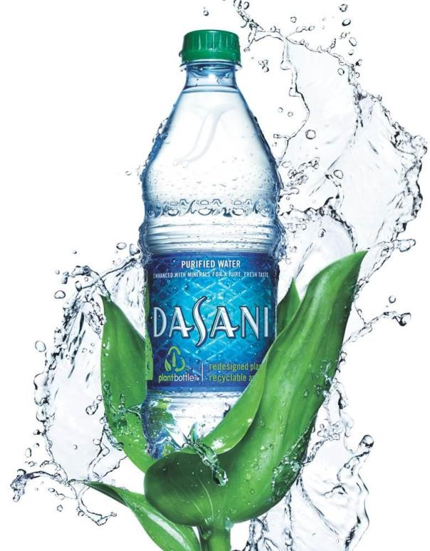
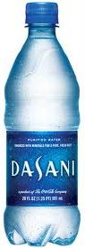
USA PLANTBOTTLE REVIVES DASANI
In 2009, consumers were leaving bottled water category due to negative perceptions of packaging’s impact on the environment
DASANI was losing volume share due to lack of differentiation in marketplace & competitive pricing
DASANI experienced delisting in major retail chains
PLANT BOTTLE STRATEGY
Reposition brand by leading in packaging sustainability
Point of Differentiation: PlantBottle as unique, ownable proof point to connect with consumers desire for a smarter bottle
Showcase brand leadership: Natural packaging cues to reinforce positive product qualities & strengthen premium positioning
Increase authorizations: PlantBottle as vehicle to meet customer demand for reduced carbon impact
2009
2012
Notes:
PlantBottle is real differentiation. It is the first ever recyclable PET plastic beverage bottle made partially from plants.
PlantBottle packaging looks, functions and recycles just like traditional PET plastic, but does so with a lighter footprint on the planet and its scarce resources.

Slide 41
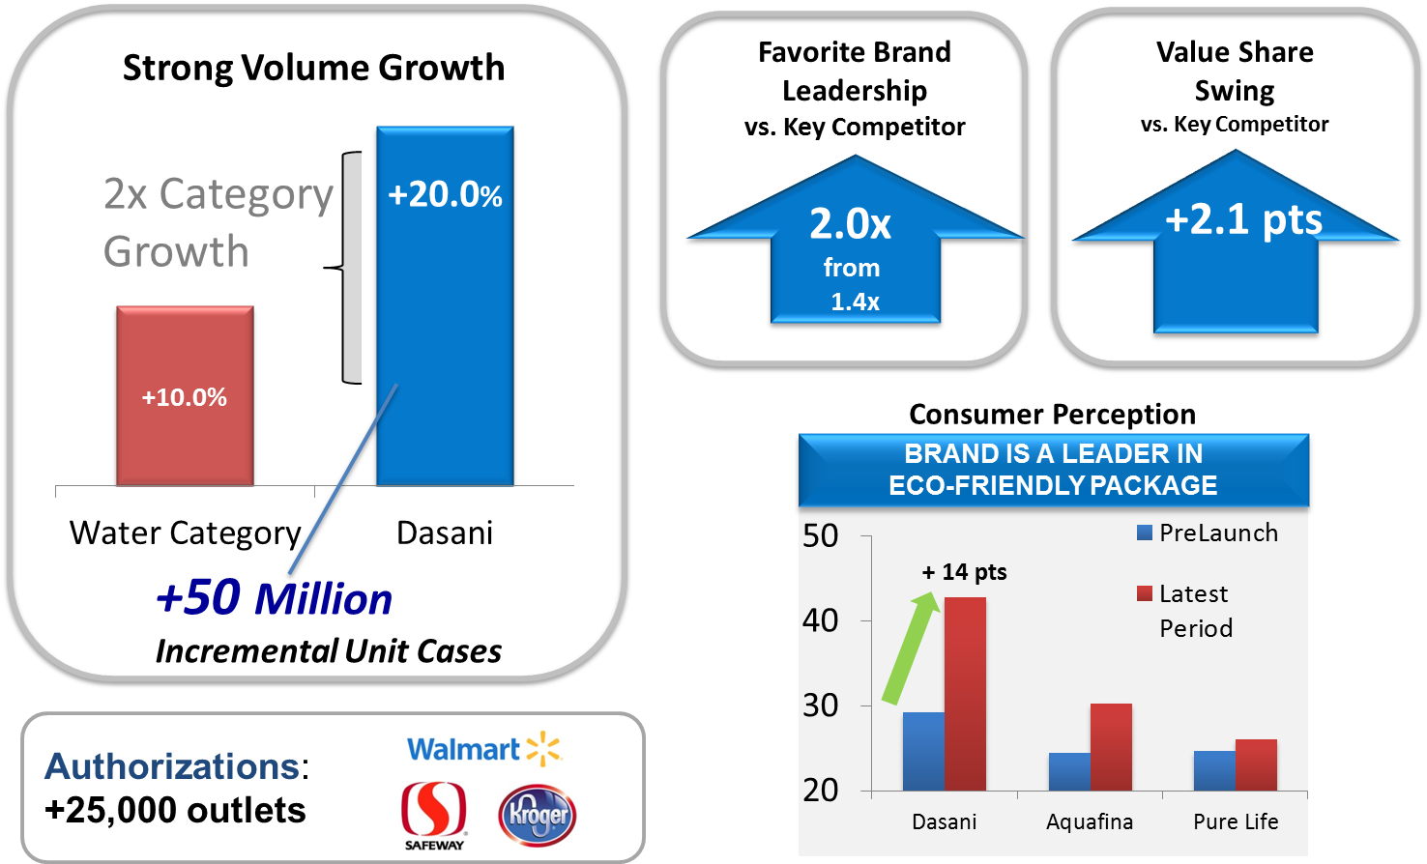
USA: PLANT BOTTLE DRIVES VOLUME, VALUE BRAND HEALTH & AUTHORIZATION LIFT
Notes:
Results
Dasani seen as ‘leader is eco-friendly packaging’
Consumers recognize Dasani as their ‘favorite brand’ more since the PlantBottle campaign began, extending its lead over the competition
Dasani saw its daily drinkers increase from 10MM to 12MM (+20%)
Dasani is winning both value and volume share
Value share has increased 2.1pts vs. competition
Volume jumped 50MM incremental unit cases, outpacing category growth 2 to 1
Dasani was reauthorized in over 25,000 outlets between 2010 and 2012, including Walmart & Safeway.

Slide 42
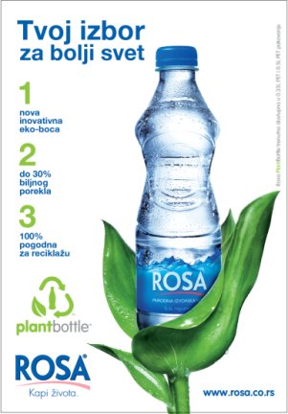
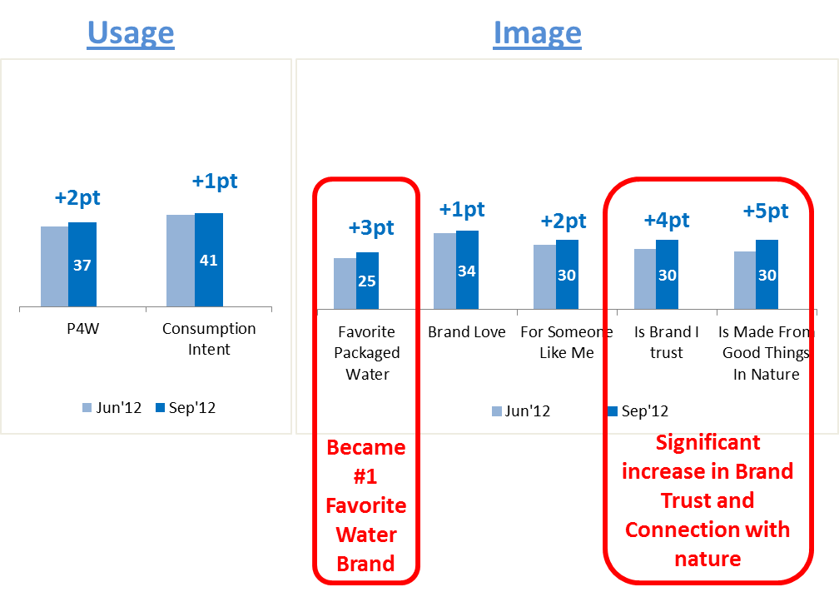
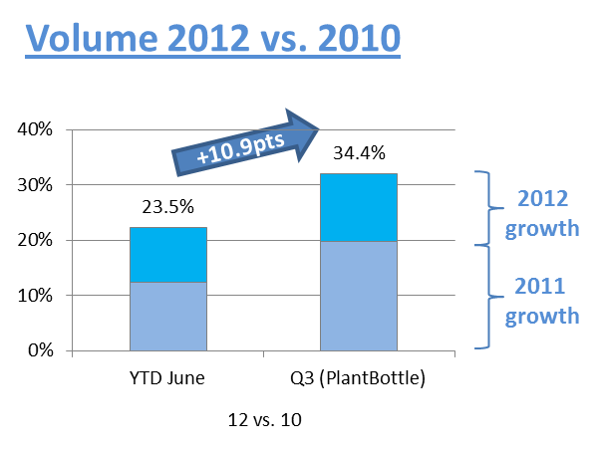
CASE: SERBIA
PLANT BOTTLE LIFTS ROSA
Notes:
Rosa (Serbia)
Serbia introduced PlantBottle to address shrinking category leadership and reboot brand that was perceived as “old and undifferentiated”
Results
Volume growth, back on double digit trend
Rosa is clear #1 Still Water - YTD Sep12 27.1% (+2.6pts vs. LY, +5.8pts vs. 2LY)
Rosa increases its gap with Aqua Viva, on all parameters
Rosa became Favorite Packaged Water Brand
Rosa is within Top 5 AFB brands in Brand Trust
Rosa is #1 player in local AFB digital arena with FB page of 165.000 fans
Rosa now is pure, healthy, persistent, composed, traditional, trustful, family oriented, yet at the same time up to dated, modern, dynamic and urban (Censydiam Jun12)

Slide 43
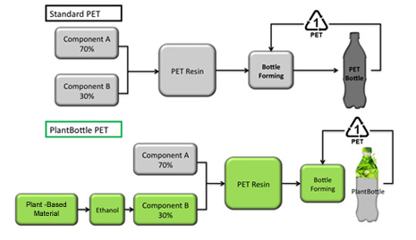
PLANTBOTTLE RESIN IS PET RESIN
The only difference is that the MEG is sourced from plants as opposed to oil. MEG is 30% of PET by weight.
Notes:
The only difference is that the MEG is sourced from plants as opposed to oil. MEG is 30% of PET by weight.
The innovative breakthrough is that it is partly made from plants as opposed to oil.
Fully recyclable
Cost competitive to oil-based PET
Commercially viable today

Slide 44

PLANTBOTTLE PET AS YOU KNOW IT
PlantBottle is the only bottle that is Functional + Recyclable + Renewable

Slide 45

PLANTBOTTLE RESIN PRICES
Global procurement targets for PlantBottle™ have been met or beat every year since introduction:
2010 Target: 15-20% (14.5% Achieved)
2011 Target: 10-15% (6.5% Achieved)
2012 Target: 10-15% (14% Achieved)
Market conditions look very favorable for PlantBottle program over next couple years with traditional MEG prices increasing
Global average on-cost for PlantBottle expected to drop to 7% in 2013.
Water packaging requires less resin than other categories. Oncost for PlantBottle is below TCCC average of $0.03 to $0.04 per unit case.

Slide 46


FRANCHISE LAUNCH COMMITMENT
INCREASING
PlantBottle currently has a small resin upcharge due to unoptimized supply chain. Long term, PlantBottle resin will be at parity or better than traditional oil-based resin.
Be creative about offsetting the upcharge in short term. Pair with savings like:
Supply chain optimization (Dasani)
Ecoflex lightweighting (iLOHAS, Ciel)
Tax and regulatory breaks (Bonaqua)
Retailer stocking fee breaks (Vio)
As the up charge is likely to be short-term, it’s important to present PlantBottle within the broader Brand strategic framework and innovation pipeline.

Slide 47

TECHNICAL GUIDANCE
NEXT GENERATION OF RESIN
The current generation of PB is just the beginning. Total decoupling from oil on a commercial scale is achievable within the decade:
PlantBottle 1.0
Commercially viable today
30% plant-based
Source: industrial grown sugarcane
Biomass
Produced today
Commercially viable by 2014
30% plant-based
Source: plant waste, like corn or rice husks
PlantBottle 2.0
Produced today
Commercially viable by 2017
100% plant-based
Source: wide variety of plant waste

Slide 48

PLANT BOTTLE
ACTIVATION!
PlantBottle has proven to drive value, volume, brand health and authorizations when executed properly.
ACTIVATE
Integrate PlantBottle into brand story
OWNED: Be bold on pack
EARNED: Engage key stakeholders including local NGOs and media
SHARED: Partner with customers, they see value in proposition
PAID: Devote DME and message appropriately
Educate the System

Slide 49

PLANT BOTTLE
DRIVES CUSTOMER VALUE
US Example:
Walmart relisted Dasani because of PlantBottle and now demands more brands to convert to PlantBottle, like Simply and Gold Peak
PlantBottle has cemented annual in-store promotions for brand, example: Dasani Earth Month
PlantBottle was the reason for new FSOP partnerships like Starwood, Disney & Sea World theme parks
PlantBottle can drive a greater share of in-store support.
Customers see the benefit of PlantBottle long before consumers, as it meets customer’s sustainability goals (e.g. carbon offsetting).
PlantBottle can be leveraged to reclaim and win new authorizations.
Notes:
US Example:
Walmart relisted Dasani because of PlantBottle and now demands more brands to convert to PlantBottle, like Simply and Gold Peak
PlantBottle has cemented annual in-store promotions for brand, example: Dasani Earth Month
PlantBottle was the reason for new FSOP partnerships like Starwood, Disney & Sea World theme parks

Slide 50










OPENS
OPPORTUNITY FOR COLLABORATION
technology collaborative
50

Slide 51

CREATES
SYSTEM ENGAGEMENT
PlantBottle™ is significant innovation for which we can all be ambassadors. Create more ambassadors within the System by educating and motivating employees through on-site promotions & MyKO outreach
Every Bottle Has a Story Videos
Packaging impact and milestone exhibits
Partnership Exhibits
Hero articles on Journey homepage
Notes:
US Example:
Walmart relisted Dasani because of PlantBottle and now demands more brands to convert to PlantBottle, like Simply and Gold Peak
PlantBottle has cemented annual in-store promotions for brand, example: Dasani Earth Month
PlantBottle was the reason for new FSOP partnerships like Starwood, Disney & Sea World theme parks

Slide 52
CROSS-FUNCTIONAL COLLABORATION
SPONSOR: Ron Lewis, CPO
PROGRAM OPS
Lisa Mason-Sanders
GENERAL MANAGER
Scott Vitters
MARKETING OPS
Andrew Rodbell
GROUP LEADS
EUROPE
Klaus Stadler
RESEARCH
Yu Shi
BRAND MKTG (Coke)
G. Duncan
LATIN AMERICA
Marcelino Martinez
DEVELOPMENT
Mike Schultheis
BRAND MKTG (H20)
S. Castell
NORTH AMERICA
Chris Gaffney
PROCUREMENT
Miki Knutzen
LIVE + MKTG
Javier Rodriguez Marino
EURASIA & AFRICA
Cumhur Karci
EOSH
Himanshu Jani
CUSTOMER MKTG
Jeff Foote
PACIFIC
Marina Palma
SUSTAINABILITY
Anna Shealy
COMMUNICATION
Katherine Schermerhorn
SUSTAINABILE AG
Ben Jordan
LEGAL
Vail Thorne
FUNCTIONAL SUPPORT
SUSTAINABLE AG
Denise Knight
Ernesto Brovelli
SWEETNER
Ankush Singal (India)
Orlando de Albuquerque (Brazil)
R&D
Shell Huang
Sheng Sheng Yang
Linda Liu
Chris Mubarak
Rob Kriegel
K&I
Anne McAllester
SRA
Forrest Bayer
LEGAL
Nicole Morris (IP)
Keely Herrick (TM)
Bill Lee (R&D)
Lawton Hawkins (GSP)
Anthony Cabrera
M&A
Shellie Davis
FINANCE
Karen Davis
PAC
Kate Irvin
K. Black
Jen Ragland

Slide 53
THE BIG PICTURE
CARBON WITHIN PRODUCT LIFE CYCLE
PRODUCT
DESIGN
OPTIMIZE
VALUE
CHAIN
USE & END OF LIFE

Slide 54
DISCUSS
In your market, which suppliers are doing the most to reduce carbon in packaging?
What cases have you heard about from other local industries or companies?
Notes:
Discuss
In your market, which suppliers are doing the most to reduce carbon in packaging?
What cases have you heard about from other local industries or companies?

Slide 55

Manufacturing
Notes:
In the past our main focus has been our manufacturing sites and we are familiar with actions to improve energy efficiency and reduce carbon emissions at plants. We’ll spend less time on it today, but we will look at what are the available tools and programs that help us reduce carbon emissions as well as what Coca-Cola colleagues are doing.

Slide 56

PRINCIPAL CHALLENGES
IN MANUFACTURING
ENERGY USE
(EFFICIENCY)
ENERGY SOURCE
(CLEAN ENERGY)
Notes:
Carbon emissions in manufacturing originate from electricity consumption as well as fuel consumption, mainly fuel used in our boilers operation. The approaches to reduce these carbon emissions can be classified as a) Improvements in energy efficiency (reduce energy use) and b) Use of cleaner sources of energy (like renewable energy). The environmental and financial impacts of carbon reduction interventions will vary greatly amongst and within these approaches with low cost (and in many cases low impact) quick returns actions on one side of the spectrum and high cost high impact activities in the other. But we have developed tools and programs to help our bottlers navigate the options and build the business case

Slide 57
MANUFACTURING CURRENT METRICS
15%

Slide 58
Carbon emissions ratio improved 19% in 2012 vs 2004

Slide 59
2015 Target= 0.38
EUR improved 18% in 2012 vs 2004

Slide 61
IMPROVING ENERGY EFFICIENCY & REDUCING CARBON EMISSIONS
Tools?
Top 10 Energy Savings Program
Step by Step Guidelines for Top 10 & Next Top 10
esKO Website
Energy Savings Calculator & EUR Target Tool
Driving Energy Efficiency through OE
Other tools being developed:
Clean Energy Toolbox
Energy Conversion Tool
EUR for Combined Production Sites

Slide 62
BASIC HIGH-RETURN PRACTICES TOP 10 PROGRAM
1
2
3
4
5
6
7
8
9
10
Fix air leaks
Repair steam leaks
Upgrade pipe insulation
Reduce compressed air pressure
Eliminate air knives
Implement high efficiency lighting
Maintain HVAC
Collect steam condensate
Evaluate all set points
Implement employee awareness program
Notes:
Inside of esKO, you’ll find the top 10 simple, high-return practices that 100% of Coca-Cola bottlers should by the end of 2013. With what you’ve heard about the future of energy, this practice is even more important than ever.
ASK
How many people know what it is?
(Audience should describe if so.)
The practices are simple, they help control costs, they can help reach almost 60% of our facilities’ carbon goal, and, as a bonus, successful bottlers receive global recognition for your environmental work. It gets better. Together with World Wildlife Fund – we launched an EASY new web tool in TEN LANGUAGES so that your plants can log-in, view practices, and track their progress. The entire process takes no longer than 15 minutes. The site is available in: Arabic, English, French, German, Hindi, Japanese, Mandarin, Portuguese, Russian, and Spanish
RESOURCES
Please log-in with your esKO credentials now at https://www.tcccgws.com/wwf/login/login.asp.
If you need access to esKO or the Top 10 Toolkit, contact Carlos Pacheco, capacheco@coca-cola.com.

Slide 63

RESULTS PROGRAM IMPLEMENTATION

Slide 64


Program Benefits:
EUR Reduction!!
System Savings of > US$1 Billion in Last 8 Years due to Energy Efficiency

Slide 65

INTERNATIONAL AND SYSTEM WIDE RECOGNITION!

Slide 67


PRACTICE 1 REPAIR COMPRESSED AIR LEAKS
Implement regular program for surveying for and repairing compressed air leaks (consider using an ultrasonic detector)
There is a program for air leaks which indicates that the air leaks should be surveyed once a month by audial and visual techniques.

Slide 68


PRACTICE 2 REPAIR STEAM LEAKS
Implement regular program for surveying for and repairing all steam leaks (including faulty steam traps)
Steam leaks are programmed to be surveyed once a month by audial and visual techniques. In addition, they are checked periodically once in every 3 months by using thermal camera.

Slide 69


PRACTICE 3 REPAIR HOT & COLD PIPE INSULATION
Implement regular program for surveying for and repairing all hot & cold pipe insulation, including valves (consider using a thermal camera)
Hot & cold pipe insulations are programmed to be surveyed once in every 3 months by using thermal camera.

Slide 70




PRACTICE 4 REPAIR HOT & COLD PIPE INSULATION
Insulation Jacket Implementation
BEFORE
AFTER
Insulation on washing machines

Slide 71


PRACTICE 5 ELIMINATE COMPRESSED AIR KNIVES
Eliminate the use of compressed air knives as much as operationally possible. (Use blowers instead.)
Air knife is used only at Line-1 which has lower cost than blower and it is a necessity for the high filling rate of 42.000bottles/hr. In other 3 pet lines, total 4 air knives have been replaced with only 2 blower. In 2 pet lines, discharge air of vacuum pumps is fed to bottles instead of air knife with ‘Zero Energy Consumption’

Slide 72


PRACTICE 6 CONVERT TO HIGH-EFFICIENCY PLANT LIGHTING
LINE-2 – DAYLIGHT ILLUMINATION
LINE-1 – DAYLIGHT ILLUMINATION

Slide 73



OFFICE-LED LIGHT ILLUMINATION
PALLETIZING-T5 ILLUMINATION
OFFICE- DAYLIGHT ILLUMINATION

Slide 74
INTERMEDIATE ACTIONS
NEXT TOP 10
11
12
13
14
15
16
17
18
19
20
Implement Energy Management System
Improve boiler efficiency
Improve air intake to compressors
Reduce bottle blower air pressure
Central chilling system and increase filling temp.
Cool raw water inlet with cooling tower
Optimize compress air pipe layout
Use variable speed drives
Recover air from bottle blower
Recover heat from boiler
Notes:
Inside of esKO, you’ll find the top 10 simple, high-return practices that 100% of Coca-Cola bottlers should by the end of 2013. With what you’ve heard about the future of energy, this practice is even more important than ever.
ASK
How many people know what it is?
(Audience should describe if so.)
The practices are simple, they help control costs, they can help reach almost 60% of our facilities’ carbon goal, and, as a bonus, successful bottlers receive global recognition for your environmental work. It gets better. Together with World Wildlife Fund – we launched an EASY new web tool in TEN LANGUAGES so that your plants can log-in, view practices, and track their progress. The entire process takes no longer than 15 minutes. The site is available in: Arabic, English, French, German, Hindi, Japanese, Mandarin, Portuguese, Russian, and Spanish
RESOURCES
Please log-in with your esKO credentials now at https://www.tcccgws.com/wwf/login/login.asp.
If you need access to esKO or the Top 10 Toolkit, contact Carlos Pacheco, capacheco@coca-cola.com.

Slide 75


NEXT TOP 10
Optimize compress air pipe layout
Central chilling system and increase filling temp

Slide 76

CASE: COCA-COLA WIND FARM
ENERGY RECOVERY
Carbon Emissions Reduction of 825,000 tons per year
Notes:
Coca-Cola in Dongen partnered with Ardagh Packaging’s nearby facility to run a pilot to establish whether the residual heat released at Ardagh's during glass production, is suitable as a source of energy for the production of drinks in the Coca-Cola Enterprises factory in Dongen. Coca-Cola Enterprises is hoping that, should the tests succeed, this will result in energy savings of 15 million kWh per annum. That is 30 percent of the total energy required to run the factory.

Slide 77

CASE: COCA-COLA PARTNERS WITH ARDAGH
ENERGY RECOVERY
Notes:
Coca-Cola in Dongen partnered with Ardagh Packaging’s nearby facility to run a pilot to establish whether the residual heat released at Ardagh's during glass production, is suitable as a source of energy for the production of drinks in the Coca-Cola Enterprises factory in Dongen. Coca-Cola Enterprises is hoping that, should the tests succeed, this will result in energy savings of 15 million kWh per annum. That is 30 percent of the total energy required to run the factory.

Slide 78


PARTNERSHIP IN REDUCING CARBON IN OPERATIONS
THE WWF ROLE IN TOP 10
Notes:
But it is not just about business, it is also about Societal Impact, and our impact as a members of the community.
An important part of our World (Environment) commitment is our partnership with the World Wildlife Fund.
ASK:
How many people knew about the partnership before today?
What does the partnership do?
Through the global partnership Coca-Cola and WWF have committed to conserve and protect our freshwater resources. We are:
helping ensure healthy, resilient river basins in 11 key regions
measurably improving environmental performance across the company’s value chain
integrating the value of nature into public and private decision-making processes
convening influential partners to help solve shared global challenges
Engaging in climate reduction is an essential part of our initiative – to preserve our water, to serve our community.
It’s not just good business sense. It’s good corporate citizenship.
At that same time that we say it’s not about business, let’s talk about how our partnership with WWF was very good for business.

Slide 79

INTERVIEWS: HOW TO ENGAGE IN CLIMATE ACTION
TCCC + WWF Asked: 15 Bottlers + 3 Peers/Competitors

Slide 80

BOTTLER VALUES
Performance (money, return)
Brand value/recognition (reputation, recognition)
What other bottlers are doing to succeed
Employee morale
Doing the right thing

Slide 81
IMPORTANT SUGGESTIONS
Communications
Information Flow
Current Channels + Tactics
Partnership
More Recognition
More Support – WWF + KO
Strategy
Include Bottlers in Strategy/Decision Making
Align Incentives/Priorities + Provide Awards
Provide Implementation Support After Audits & Pilots
And Much More…

Slide 82

TOP 10 ENERGY SAVING CHALLENGE
GET SCORE & CUSTOMIZED IMPROVEMENT PLAN
Notes:
Here’s how it works – Matt explains the web site.

Slide 83

SUITE OF TOOLS IN 10 LANGUAGES

Slide 84

INCLUDING
BOTTLER SPOTLIGHTS
Notes:
The Bottler Spotlight testimonials provide a map for how to get the Top 10 done.

Slide 85

INSPIRING THROUGH INNOVATION
In 2012, Coca-Cola Icecek’s Izmir bottling plant became the first of Coca-Cola’s bottling facilities to complete the Top 10 Energy Saving Challenge.
Through innovation, the plant has achieved an energy use ratio 19% below 2006 levels.
The successes achieved at Izmir have been mirrored by 7 additional Icecek plants, earning the group a Platinum Certificate from the partnership.
© Mutlu Babacan
Notes:
RESULTS – see slide
Photo: Coca-Cola Icecek’s Izmir bottling plant manager, Mutlu Babacan, and his team accepting Coca-Cola’s Presidents Award for “Best Performing Plant in the Eurasia a
To date, 526 of the system's 863 manufacturing facilities are implementing the practices
127 have completed the entire Top 10 challenge
More than 270 have made at least 80 percent progress and Africa Group”

Slide 86

Distribution
Notes:
Because of the high cost of fuel, most Fleet Fuel Economy improvements are clear wins. While some may require investment (like hybrid trucks since many markets may not have the rebates and incentives), many of the fleet fuel economy improvements are low- or no-cost. For example, just acting on speed control (based on the successes CCR) could save the system $78MM per year. What’s your piece of that pie?

Slide 87

PRINCIPAL CHALLENGES
IN DISTRIBUTION
FUEL USE
LOGISTICS/ EFFICIENCY
TIME = MONEY
Notes:
STRATEGIC FRAME
We’ll start by understanding the principal challenges in distribution:
Fuel use = fuel cost
Better logistics = efficiency = savings
Time = money
FINANCIAL FRAME
The financial benefits in distribution are varied.
There are great benefits that lie in reducing fuel cost through practices like driver training or from practices like investing in modernizing the fleet.
And there are logistics practices that save fuel, time, and money.
STRATEGIC FUTURE
When we consider the rising cost of fuel, looking into better distribution practices is business critical. And an easy area for collaborating with suppliers.
Let’s talk about what some of our peers are taking on.

Slide 88



PRACTICE
NO IDLING POLICY
Idling just 5 minutes a day puts up to 300 pounds of carbon dioxide and other air toxics into the atmosphere each year.
Notes:
Idling costs a great deal to our network of bottlers each year.
Trucks consume up to one gallon of diesel fuel for each hour at idle, using as much as 2,400 gallons (approximately USD 10,000) of fuel every year per truck. From trucks in the US alone, this totals 1.2 billion gallons of diesel fuel consumed every year. On average, each idling truck produces about 21 tons of carbon dioxide (CO₂) and 0.3 tons of nitrogen oxides (NO_{x}) annually.
But what else does idling cost YOU? Not just fuel and carbon, but life of the vehicle oil: Idling causes twice the wear on internal parts compared to driving at highway speeds, increasing maintenance costs and shortening engine life. Prolonged idling can reduce the operating life of engine oil by 75%.
With SIMPLE driver behavior changes, you can save ~$10,000 a year per truck in fuel and 21 tons of carbon dioxide (CO₂) and 0.3 tons of nitrogen oxides (NO_{x}) annually per truck. That’s a lot of money, a lot of carbon, and a lot of wear and tear. In our system, extrapolating from a project at CCWJ (Japan) example, idle reduction represents a $54MM per year fuel cost savings opportunity.
Let’s look at a case.    (Let audience choose which case and share case and see text below.)
We often default to expensive engineering solutions for our GHG projects. We feel daunted by budgets, but there are low-cost behavioral changes all around us. How do we identify those? But these kinds of changes matter? How do we take advantage of those?
WAL-MART
When not actively driving, truck drivers tend to idle their vehicles for a few reasons: to warm up the engine before driving; to avoid wear and tear on the engine in situations that require frequent restarting; talking on cell phones while parked in the vehicle; and to keep warm in cold temperatures or cold in hot temperatures while in the vehicle. To stop much of the idling in its truck fleet, Wal-Mart Trucking installed auxiliary power units in cabs for truck drivers for air conditioning, heating, and electronics when they sleep overnight. Wal-Mart installed the units in 100% of its trucks saving millions in fuel costs. In 2005 alone, Wal-Mart saved 25 million USD.
GREEN MOUNTAIN COFFEE ROASTERS
GMCR equipped the company’s heavy duty trucks with telemetric systems to provide detailed engine data including % of runtime that the engine is idling. GMCR found that the trucks were idling 28% of the run time. Two years after GMCR started to measure telemetric data it has reduced idling to 10% of run time resulting in a 4% savings of fuel annually. By 2009, GMCR had already reduced idling to only 3%, resulting in savings of 7,000 gallons of diesel fuel, avoiding 152,000 pounds of CO2 emissions and saving more than $20,000 a year from idle reduction.
How can you do it?
While GMCR utilizes truck telemetrics, a viable lower cost alternative for monitoring engine data are Engine Control Modules (ECMs). Many modern engines are equipped with ECMs that make available data of vehicle operational parameters. A customized data logger or similar device would need to be installed on most vehicles to read this data and track engine idling, and determine how much fuel and money is saved. This would pay for itself in short order. However, while recommended, it is not essential for vehicles to utilize these systems to institute an idling reduction policy. The main and virtually cost-free component is to establish a definitive policy or practice that clearly and regularly informs company fleet drivers of the multiple benefits of idling reduction.
UPS
Since the time UPS drivers adhere to a no-idling policy to help reduce fuel consumption and harmful emissions, UPS has cut the amount of time delivery vehicles idle by 24 minutes per driver per day – a fuel savings of $188 per driver in one year (100,000 vehicles delivering over 15 million packages and documents worldwide each day). UPS conserves around 10 million gallons of gas of fuel per year, which equates to 100,000 Tons of CO2 Emissions per year.
Since the deployment of its route planning technology in 2004, UPS has eliminated millions

Slide 89


CASE
CCE BIOGAS TRUCKS
Notes:
Powered from methane from a landfill in Surrey, England. Will cut carbon emissions 50% over the life of the vehicle.

Slide 90

PRACTICE
INBEV SHARED LOGISTICS
5 MILLION LTRS FUEL
500,000 M TONS CARBON
SHARED FLEET LOGISTICS
Started with 6 shared routes Sara Lee, Unilever, Sadia, etc.
Notes:
InBev launched the Shared Fleet Logistics Project in Brazil in 2009 with six routes to optimize the usage of fleet. Rather than returning empty after delivering products to its distribution centers,
 InBev’s logistics planned for its trucks to carry loads back from partner companies such as Sadia, Sara Lee, and Unilever among others. The success of the project is also due to the use of the software Transportation Management System, which identifies synergies with other companies to make our fleet more efficient.
RESULTS
The program has saved nearly 5 million liters of diesel fuel and prevented the emissions of more than 500,000 metric tons of carbon since its inception. It has now been expanded to 10 Brazilian states, and in 2012 InBev expects a 66% increase in this type of transportation arrangement among its factories, distribution centers, and producers of inputs.
This is a great example of working together as suppliers. For example, remember back to the group of companies that Walmart structured to focus on fertilizer. Our customers WANT us to do these types of practices. And they make sense.
RELEVANCE TO COCA-COLA
CCE also has “Collaborative expansion of front and backhaul operations” efforts in place. They have been working with customers and suppliers for several years; expanding front and backhaul opportunities has reduced empty road mileage, carbon emissions, and associated cost. Customers collect their own stock on return trips and raw materials suppliers utilize their empty return runs from sites to transport goods on CCE’s behalf.
The process of network optimization is an importance element in reducing carbon emissions by making our distribution more efficient. One way that CCE is doing this is now by investing in new production and storage capacity at key sites, enabling us to minimize our long-distance freight distribution needs. In 2012, for example, CCE expanded production in France at Clamart and Marseille and we’re currently building more warehouse capacity at Wakefield in Great Britain and Dongen in the Netherlands.
How are you considering this type of strategic opportunity in your organization?

Slide 91


PRACTICE
UNILEVER STREAMLINES LOGISTICS
Logistics software system through 12-hub network,
Removes 175 million km in Europe alone (2013- 2015)
Notes:
Efficient transport management
Unilever has committed to ensuring that its CO2 emissions from its global logistics network will be at or below 2010 levels by 2020 – despite the significantly higher production volumes that will be generated as the company grows. This will represent a 40% improvement in CO2 efficiency.
In 2008, Unilever launched its own internal transport management organization, UltraLogistik, to manage transport movements across Europe. UltraLogistik finds the most efficient ways to move raw materials and packaging to our factories and then transport finished goods to around 300 warehouses in Europe. From this original initiative came the idea to establish global and regional control hubs. These enable Unilever to co-ordinate our transport activities efficiently and ensure that trucks are as full as possible.
RESULTS
 In total, the 12-hub system, promises to reduce total distance travelled by 175 million km in Europe alone from 2013 to 2015 (compared to 2010 levels). It is estimated that by the end of 2014, the project will remove annually the equivalent of around 154 000 truck voyages between Brussels and Warsaw or more than 260 000 truck voyages between Berlin and Brussels, compared to 2010 levels. Traffic reduction should happen in almost all EU member states, with particular impact in highly congested areas. Fewer trucks on the European roads network will also result in less carbon emissions. By the end of 2014, the project also expects to reduce the carbon emissions from our logistics network by around 15 000 tons of CO2 each year, compared to 2010 levels.
RELEVANCE TO COCA-COLA
Climate Ambassadors can help bring best practice ideas and the carbon perspective to critical areas – like fleet and logistics – inside the company. (You may want to share this video http://www.youtube.com/watch?v=_EIgAVHnqDo with your logistics team.)

Slide 92

PRACTICE
PERFECT PALLET DESIGN
RESULTS
>40 perfect pallet projects
↓ diesel fuel 380,000+ gallons
Saved 2 million miles (enough to circle the Earth 80 times)
*Picture is illustrative, not actual pallet used.
Notes:
How can the perfect pallet circle the earth 80 times?
Since 2009, ConAgra has implemented more than 40 perfect pallet projects, which have reduced diesel fuel use by more than 380,000 gallons, and have taken more than 2 million miles off the road — enough to circle the Earth 80 times. Combined, these projects have cut greenhouse gas emissions by more than 3,900 metric tons.
For example, in fiscal 2012 ConAgra optimized the package size of three Crunch ’n Munch® SKUs, allowing more units to fit on each pallet. The Crunch ’n Munch® project alone conserved more than 10,000 gallons of diesel fuel and cut greenhouse gas emissions by more than 100 metric tons.
RELEVANCE TO COCA-COLA
What does that mean for Coca-Cola? It means that there are big opportunities to reduce waste across all areas of the business. Bottling partners are taking this challenge on in interesting ways. How many of you know how much waste there is in your distribution chain and where it is?

Slide 93

PRACTICE: ADM CREATES
PLANT-BASED COOLANT
PROBLEM
Coolant (propylene glycol) in our engines and machinery is a significant contributor to GHGs
BIODIESEL WASTE
61% GHG
Notes:
The use of coolant (propylene glycol) in our engines and machinery is a significant contributor to greenhouse gas due to its highly energy-intensive manufacturing process. The manufacturing of propylene glycol is highly energy intensive*. Coca-Cola companies use a great deal of coolant:
Big engines can contain 20-30 gallons of propylene glycol.
Other equipment and like HVAC chillers can hold far greater amounts as a heat/cool transfer fluid.
 GHG RETURN
Plant-based coolant (propylene glycol) can be used instead of the energy-intensive petroleum-based coolant to reduce the related greenhouse gas emissions by 61%.
COST
Using Plant-based coolants to replace GHG-intensive petroleum-coolants can take that on. According to ChemSystems analysis of the product (see case), at current fuel prices (and therefore current coolant prices) these coolants should have a cost advantage over other coolants.
INSTRUCTOR NOTES:
What is Plant-based coolant?
Plant-based coolant is derived from soybeans or canola. The process involves crushing, de-hulling, conditioning, flaking and extraction crude vegetable oil from soybean or canola seeds. This vegetable oil is further processed into refined oil. The refined oil is then transformed through a trans-esterification process into crude biodiesel and crude glycerin (by-product). Glycerin is further processed through evaporation and distillation steps into glycerin. Glycerin is further processed into propylene glycol. The propylene glycol is further distilled into an industrial-grade or a USP-specification-grade propylene glycol. The process of changing glycerol to propylene glycol is a simple chemical reaction that uses no environmentally harmful chemicals and uses only water for solvent; thus minimizing risk of harm to the environment. The solid catalyst used in the process has a long life and, when exhausted, the metals can be reclaimed and recycled rather than sent to a landfill.

Slide 94
If you’re not looking at reducing fuel and carbon in distribution….
more than carbon is going up in smoke.
SMALL AREAS OF WASTE ADD UP
IN CARBON AND FUEL COSTS.
Notes:
If you’re not looking at being more efficient, in reducing fuel and carbon in distribution….
more than carbon is going up in smoke.
SMALL AREAS OF WASTE ADD UP IN CARBON AND FUEL COSTS.

Slide 95
EMISSIONS ARE ENERGY
(ENERGY IS MONEY)
Notes:
The gorilla is back.

Slide 96

Refrigeration
Notes:
Refrigeration contributes about 30% or more of emissions to most of our products and, of course, implies significant costs to our customers. Figuring out good solutions in refrigeration is not simply a matter of lowering emissions, but also a mattering of being conscientious customers.

Slide 97

PRINCIPAL CHALLENGES
IN REFRIGERATION
ENERGY USE
INSULATION
COOLANT
ENERGY SOURCE
Notes:
STRATEGIC FRAME
We’ll start by understanding the principal challenges in refrigeration:
Energy use
Insulation
Energy source
FINANCIAL FRAME
In the case of refrigeration, most of the financial benefits accrue to our suppliers – those retailers who are selling our products. And they are saving dramatically with action in this area.
STRATEGIC FUTURE
So, while we’re not yielding savings, we’re becoming better partners – and that is a critical place. Alongside that: more and more suppliers are expecting this from us. Remember the Walmart case – we need to do this.
Let’s look at action in this area.

Slide 98

PRACTICE AT COCA-COLA
ENERGY MANAGEMENT SYSTEM
PROBLEM
Refrigeration contributes about 30% or more of emissions to most of our products.
35% LESS ENERGY (compared to 24hr without EMS)
FEWER SERVICE CALLS (less time running)
Notes:
Here’s a case in spotlight.
THE ENERGY MANAGEMENTSYSTEM IS AN ENERGY MANAGEMENT DEVICE
To keep language straight:
EMS is the device
EMD is the category of all types of devices
The Coca-Cola Company has developed a proprietary device called energy management system (EMS) that reduces energy consumption of a cooler by up to 35% by allowing the temperature inside the cooler to rise (between 7°C to 14°C) during periods when the outlet is closed and maintains the correct cooler temperature (between 0°C and 7°C) during the active hours of the outlet. The EMD manages this by detecting the people movement in-front of the cooler through an infrared sensor eye & through the cooler door opening and closing counts. The EMD was tested in 2003 and 2004 and commercialized at the end of 2004 by Elstat Electronics ltd. under licence from The Coca-Cola Company. This device is based on a design that is owned by TCCC and offered for use exclusively to Coca-Cola companies, but TCCC can authorize the use of this device for the adjacent businesses of our key Bottling partners (for example the FEMSA / SABMiller Beer Businesses)
Since we began tracking sales in detail (June 2005) Elstat has sold over 50,000 EMS devices to suppliers of The Coca-Cola System bottlers.
Globally, using the Energy Management System could save:
$1.1 billion/year ($78/year per unit; cost: $40/unit) – total investment ~$590 million
From EMSs on one-fourth of KO’s equipment already we are saving customers over $300 million per year. That’s part of being a good supplier, investing to make our customers do well.
 RESULTS
The EMD can substantially reduce the number of service calls whilst saving on average up to 35% energy (when compared with a 24hour running cooler without EMS). The EMD facilitates longer life to the compressor, fans and lights in a cooler, by protecting against High voltage (> 250V) & Low voltage (< 180V) supplies and saves maintenance cost of the cooler owner. All the cooling equipment of more than 250 liters capacity that we bought in 2009 were 100% fitted with EMD which is also mentioned on the cooler body (labels). Coca-Cola has also made 100% transition to HFC free (Hydroflourocarbons free) insulation foam for our cold drink equipment.

Slide 99
CASE: A FINANCIAL CASE FOR
REFRIGERATION TRANSITION - EMD
ENERGY MANAGEMENT DEVICES
Cost an average of $40 each (incremental)
Saves $78/year
Total incremental investment (through 2020): $588 million
Annualized avg. savings: $1.15 billion/year
Retirement Rate
Cooler CAGR
2010 MEC KWh/d
Notes:
The EMD is one device, but let’s look a the business case for transition at a global scale.
· Virtually all of our cold drink equipment will be replaced with more efficient units during the decade 2010-2020.
· In 2011, the system had 13.5 million units of cold drink equipment.
· Over the period 2011-2020, we will be buying 14.7 MM units of cold drink equipment.
· We will also be retiring 8 MM units over that time period.
· Our total population of cold drink equipment will be over 20 MM in 2020.
· The units we have placed ALREADY are 40-50% more efficient than the vintage 2000 units they replaced.
· Units we place 2013-2017 will be 10% more efficient than today.
· Units we place 2017-2020 will be 25% more efficient than today.
· The net result will enable more immediate consumption (high margin) volume with LOWER overall emissions (-10% vs. 2010)

Slide 100
CASE: A FINANCIAL CASE FOR
REFRIGERATION TRANSITION - LED
LED LIGHTING
Cost an average of $42 each (incremental)
Saves $19/year
Total incremental investment (through 2020): $617 million
Annualized avg. savings: $279 million/year
Retirement Rate
Cooler CAGR
2010 MEC KWh/d
Notes:
And then there is LED lighting:
Cost an average of $42 each (incremental)
Saves $19/year
Total incremental investment (through 2020): $617 million
Annualized avg. savings: $279 million/year

Slide 101
CASE: A FINANCIAL CASE FOR
REFRIGERATION TRANSITION - COMPRESSOR
VARIABLE SPEED COMPRESSORS
Cost an average of $70 each (incremental)
Saves $113/year
Total incremental investment (through 2020): $1.03 billion
Annualized avg. savings: $1.66 billion/year
Retirement Rate
Cooler CAGR
2010 MEC KWh/d
Notes:
And Variable Speed Compressors
Cost an average of $70 each (incremental)
Saves $113/year
Total incremental investment (through 2020): $1.03 billion
Annualized avg. savings: $1.66 billion/year
Not a small bit of savings.

Slide 102




HFCs: ALL NEW CDE, HFC-FREE
A LEADERSHIP COMMITMENT
Coca-Cola leading the pack to catalyze change in an industry.
> 2.5 million HFC-free refrigeration units around the world
phased out >1 million tons of CO₂ equivalent (avoided HFC refrigerant emissions)

Slide 103
BACK TO
THE BUSINESS CASE
GOAL
Reduce carbon of the drink in your hand (25%) by 2020 (2010 baseline)
Revenue (Market):
Reputation (Market):
Risk/Cost Avoidance (Weather/Supply & Efficiency):
Values: Personal, Community, Environment
Me, We, the World
Notes:
Back to the business case. We’ve just reviewed some sample practices that undergird the business case. These practices shouldn’t be seen as THE formula for what works for you, but a framework to start thinking of opportunity.
Revenue (Market):
Reputation (Market):
Risk/Cost Avoidance (Weather/Supply):
Values: Personal, Community, Environment (Me, We, the World)
DISCUSS
Which practices work where?
We know we need to take action – the business case is demanding it from us. The question remains: HOW doe we take action?

Slide 104

OUTSIDE OF SPHERE OF CONTROL
PARTNERING IS CRUCIAL
Notes:
Everything we’ve talked about today requires partnership. These are not transactional engineering solutions.

Slide 105

UP NEXT
Module 4 – ENGAGING SUPPLIERS
ini partnership with

